Slide 1
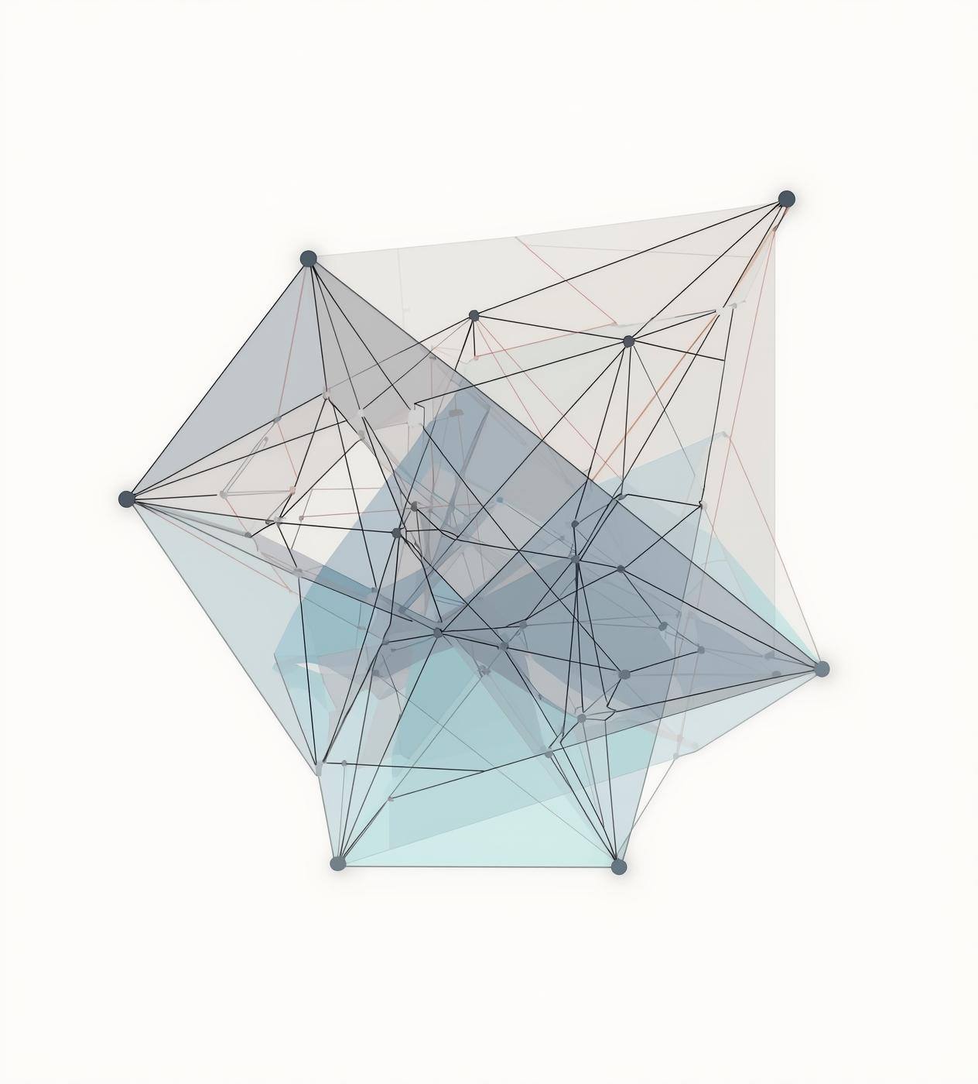
Voronoi Diagrams
Algorithm
Fortune’s Plane Sweep
Dr.Ghada Noureldein
Comp 411

Slide 2

Presented by:
Mo’men Mohsen Mashhout
Mohammed Maher Abdelfattah
Mohammed Amr Abdelfattah
Ahmad Tarek Ahmed
Khaled Emad Ezz Eldeen
Team Names
Aya Mohamed Abdelmonim Yousef
Esraa Karam Rashad
Bassant Ashraf Fawzy
Cathrine Email
Yousef Morsi Mohamed
Girgis Essam
Shahd Khaled Musa
Ahmed Ebrahim Abdelkader
Yahia mohamed mohamed
Hashem mohamed fahem
Mohamed atress mohamed
Mohamed hesham ismael
Nada Magdy Hussein
Ashrakat Hazem Mohamed

Slide 3
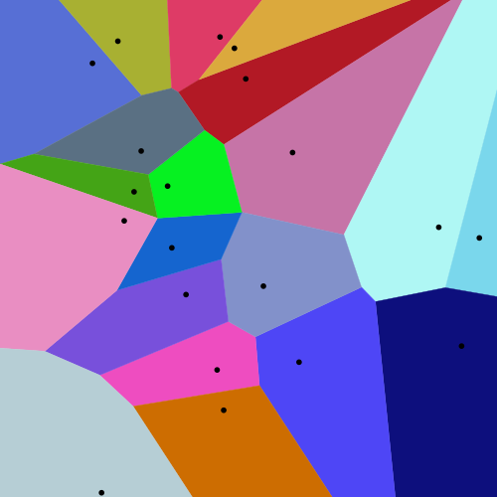
INTRODUCTION:
The Voronoi Diagram is a fundamental geometric structure that partitions a plane into regions based on distance to a set of points (called sites).
Each region consists of all points closer to one site than any other.

Slide 4
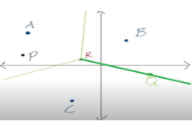
WHY VORONOI? (PROBLEM MOTIVATION):
Used to answer the nearest-neighbor problem efficiently.
Appears in many real-life applications (cell towers, hospitals, path planning, maps).
Represents influence zones of points.

Slide 5
FORMAL DEFINITION :
A Voronoi Diagram for a set of points (called sites) divides the plane into regions such that each region contains all points that are closer to one site than to any other site.
Formally, for a set of sitesFormally, for a set of distinct points 𝑃 = {𝑝1,, 𝑝2,…,𝑝𝑛} in the Euclidean plane, the Voronoi region V(𝒑𝒊) for site 𝒑𝒊 𝒊𝒔
V(𝒑𝒊) = {𝒙 ∈ 𝑹^2| 𝒅(𝒙,𝒑𝒊) ≤ 𝒅(𝒙,𝒑𝒋)∀ 𝒋 ≠ 𝒊}
Where 𝒅(𝒙,𝒑𝒊)is the Euclidean distance between 𝒙 and 𝒑𝒊.
Each point in 𝑉(𝒑𝒊) is closer to 𝒑𝒊 than to any other site.
The collection of all regions V(pi) forms the Voronoi Diagram.

Slide 6
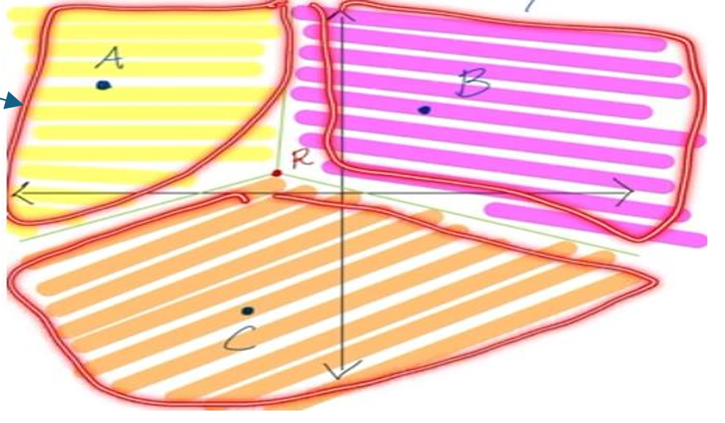
BASIC TERMINOLOGY:
Sites: A site is any point which has an area inside the diagram and helps to construct the diagram.
Cells / Regions: Points closer to one site than others.
Edges: The lines that divided the diagram into sites (areas).
Vertex: is the point in the intersection of all edges.

Slide 7
CONSTRUCTING A VORONOI DIAGRAM (2 SITES)GIVEN TWO SITES A AND B:
1. Compute the midpoint of segment AB.
2. Find the slope of AB.
3. Determine the perpendicular slope.
4. Draw the perpendicular bisector → this becomes the Voronoi edge between A and B.

Slide 8
CONSTRUCTING A VORONOI DIAGRAM (3 SITES)GIVEN A, B, AND C:
1. Construct perpendicular bisectors for each pair: AB, BC, AC.
2. The intersections of these bisectors form vertices.
3. Remove sections of lines that are closer to a third site.
4. Remaining segments form the Voronoi diagram.

Slide 9
WHY PERPENDICULAR BISECTORS?
A Voronoi edge is a set of points equidistant to two sites.
The perpendicular bisector of the segment joining two sites contains all such points.
Therefore, each Voronoi edge is part of a perpendicular bisector.

Slide 10
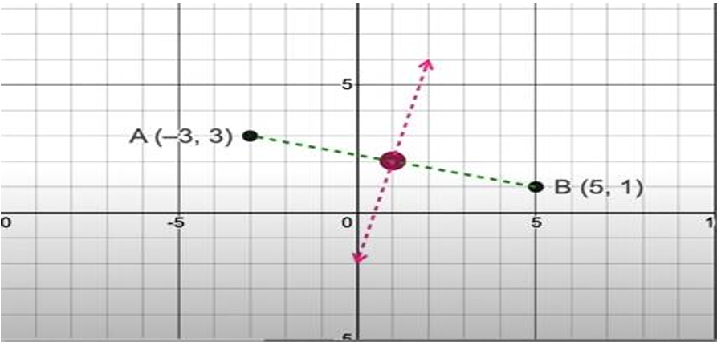
HOW VORONOI REGIONS FORM:
Voronoi edges are parts of perpendicular bisectors between pairs of sites.
Voronoi vertices occur where 3 bisectors meet — equidistant from 3 sites.

Slide 11
Real-World Applications of Voronoi Diagrams
Voronoi diagrams are not just theoretical; they appear in numerous real-life systems:
1.Artificial Intelligence & Path Planning
2.Geographic Information Systems (GIS)
3.Biology and Medical Imaging

Slide 12
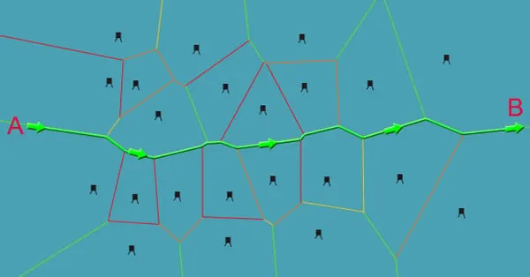
1.Artificial Intelligence & Pat Planning:
Used in robotics and autonomous navigation to generate:
Safe, collision-free paths
Routes that stay maximally far from obstacles
Stable navigation in dynamic environments
Robots often use Voronoi skeletons to compute “safe corridors” for movement.

Slide 13
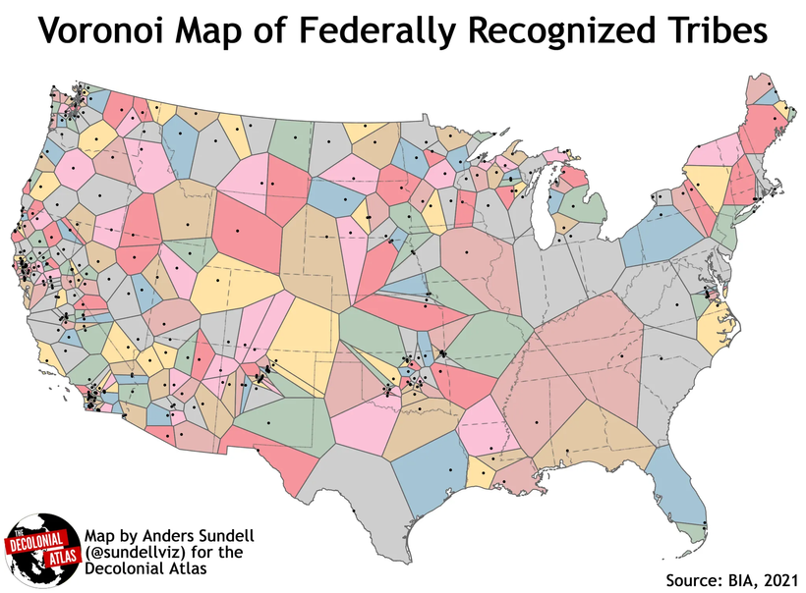
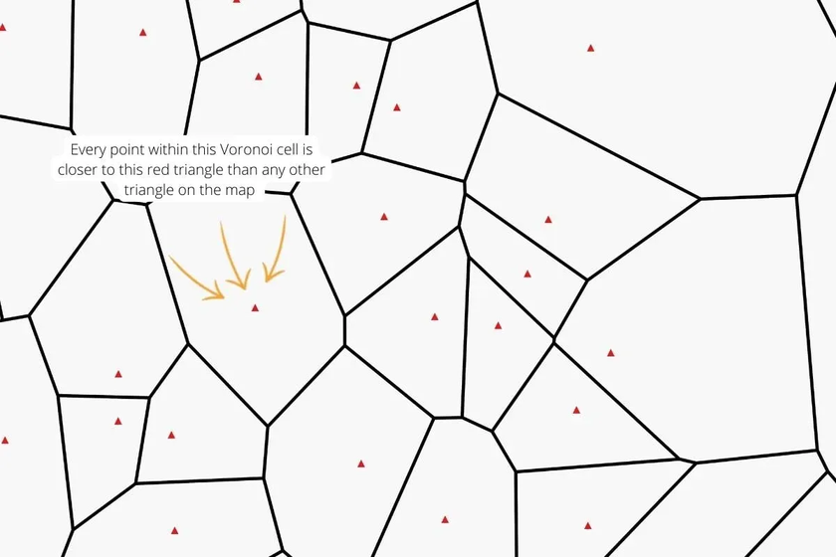
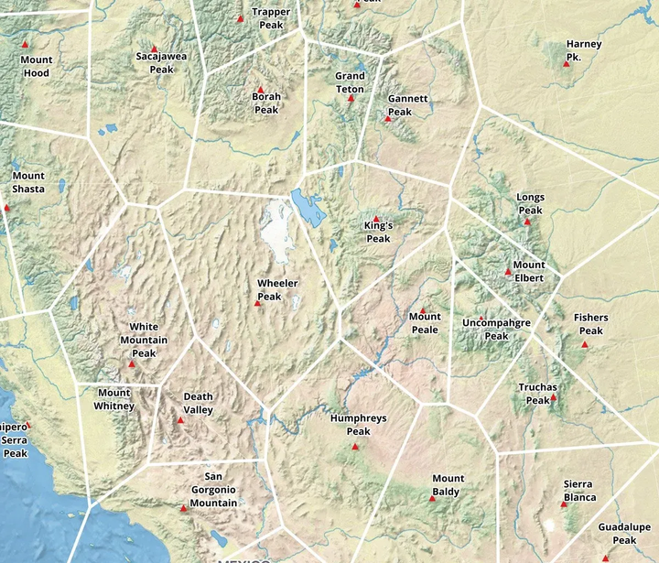
2. Geographic Information Systems (GIS):
Voronoi diagrams are used to divide geographic regions such as:
Assigning each household to its nearest hospital or fire station
Determining coverage zones for telecom towers
Studying territorial behavior in ecology or archaeology

Slide 14
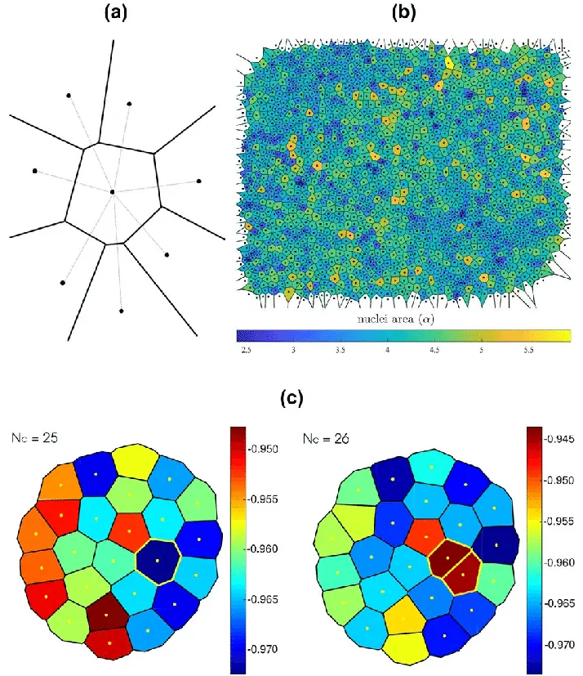
3. Biology and Medical Imaging:
Used for analyzing cellular structures,
for example:
- Modeling the shape and boundaries of
biological cells
- Understanding patterns in tissue
organization
- Analyzing spatial distribution of
organic matter

Slide 15
FORTUNE’S PLANE SWEEP ALGORITHM & TIME/SPACE COMPLEXITY.

Slide 16
EXPLANATION

Slide 17
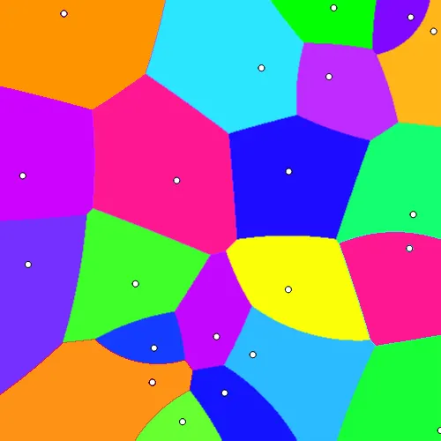
The Problem with Classical Voronoi Construction
Traditional algorithms for computing Voronoi diagrams often rely on heavy geometric operations such as half-plane intersections or incremental recomputation. making them inefficient when dealing with large datasets or real-time systems.
Additionally, these methods are not numerically stable and involve complex geometric checks that cause significant computational overhead. As a result, classical Voronoi construction is slow, complicated, and unsuitable for dynamic or large-scale environments.

Slide 18
What We Aim to Achieve
To be useful in practical applications, a Voronoi construction method must satisfy
several key requirements:
- Fast performance
- Low memory usage
- Accurate and robust geometry
- Ability to scale to thousands or millions of points
- Suitability for real-time and dynamic systems
Researchers needed an approach that avoids excessive recomputation and heavy geometric calculations, while still maintaining exactness and efficiency.

Slide 19
Explanation of Fortune’s Algorithm
Fortune’s Algorithm is one of the most elegant and powerful algorithms in Computational Geometry.
primary goal: is to construct the Voronoi Diagram for a set of points in a 2D plane.
What makes it exceptional? it achieves the optimal time & Space complexity
This makes Fortune’s Algorithm the fastest known and theoretically optimal method
for constructing Voronoi diagrams.

Slide 20
Are There Other Algorithms for Voronoi Diagrams?
Yes, several alternative techniques can compute Voronoi diagrams:
• Divide and Conquer
• Incremental Construction
• Brute-Force Half-Plane Intersection
However, these algorithms are generally slower or less stable in practice:

Slide 21
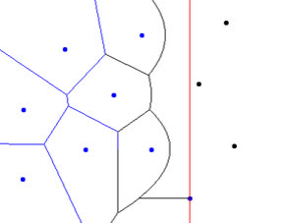
Components of the Fortune’s algorithm?
Fortune’s algorithm→ sweep-line algorithm used to construct Voronoi diagrams efficiently.
we have three main components:
Events
Sweep line
Beach line

Slide 22
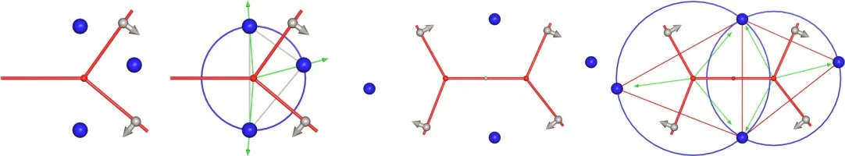
Events: Site and Circle
Events are points in time when the diagram structure needs to be updated.
Two types:
Site Events: which occur when the sweep line reaches a new site.
→ A new parabolic arc is added to the beach line.
Circle Events: happen when three consecutive arcs form a circle that shrinks to a point.
→ The middle arc disappears, and this marks the creation of a Voronoi vertex.

Slide 23
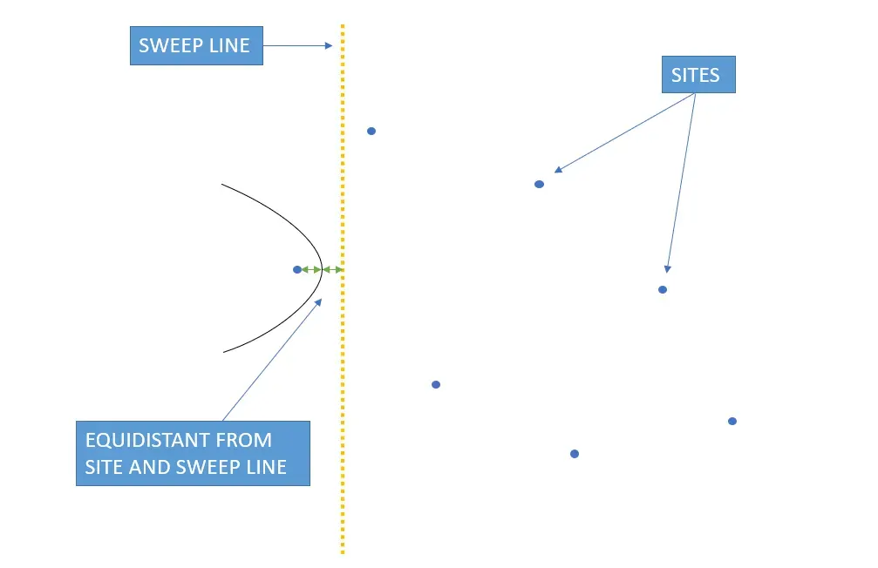
Sweep line
An imaginary horizontal line that moves from the top of the plane downward.
Main role: to determine which sites have been Activated and to order events as the line moves.
It doesn’t store data but give updates to the beach line.
When a site event occurs, a new arc appears
When a circle event occurs, an arc is removed and a Voronoi vertex is created.
In short, it converts a 2D problem into an ordered steps.

Slide 24
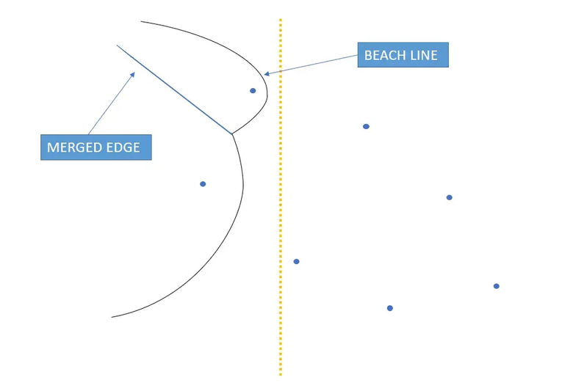
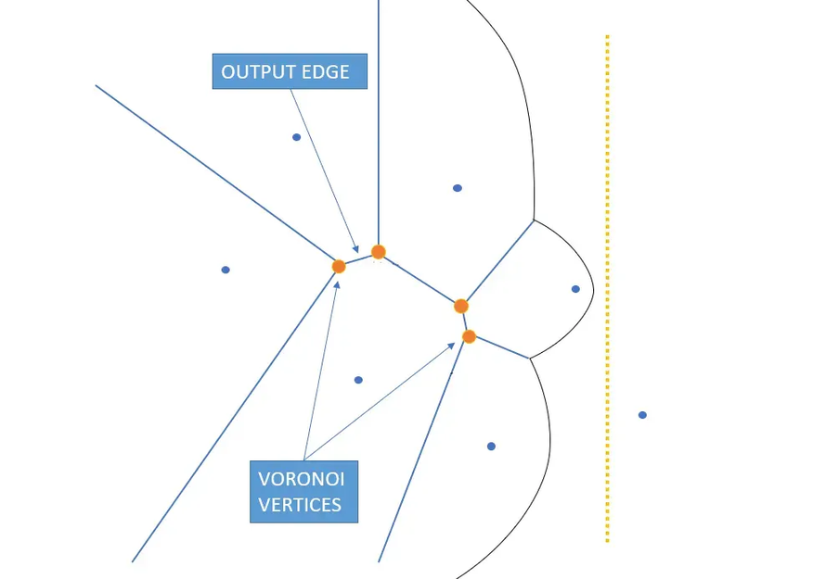
Beach line
it's the dynamic curve formed by parabolic
arcs representing the current influence regions
of all processed sites.
When a site event occurs, we insert a new arc.
When a circle event occurs, we remove an arc.
As the sweep line moves, the breakpoints shift,
tracing out the edges of the Voronoi diagram.

Slide 25
conclusion:
Here’s how it all comes together:
Events tell us when to update
Sweep line manages the order
Beach line keeps track of the current geometric state.

Slide 26
DATA STRUCTURE

Slide 27
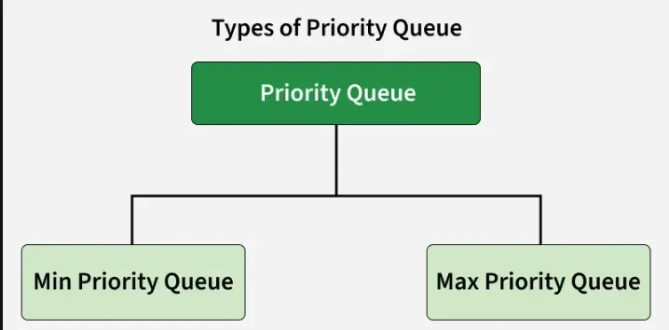
In Fortune’s algorithm, two main data structures are used. The first is a priority queue, which stores all the site events and circle events and always gives the next event in order.

Slide 28
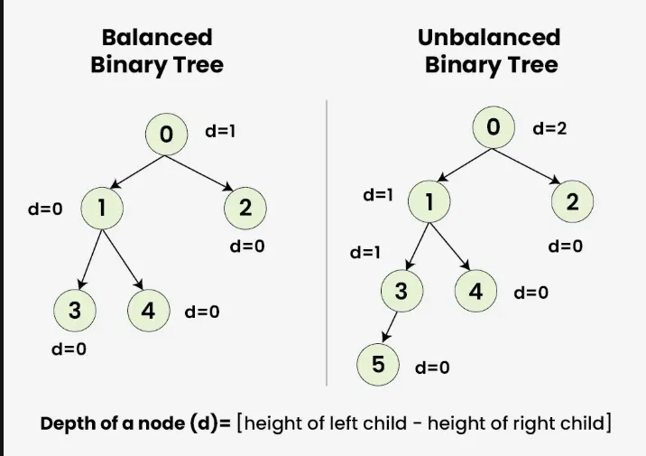
The second is a balanced binary search tree, which represents the beach line and allows the algorithm to insert, remove, and find arcs efficiently as the sweep line moves.

Slide 29
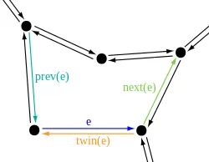
For the other Voronoi algorithms, Divide and Conquer uses a DCEL (Doubly Connected Edge List) to store the edges and faces of the diagram, along with convex hull structures during the merge step
. A DCEL is a core data structure in computational geometry that efficiently represents the vertices, edges, and faces of a planar subdivision and keeps track of their connectivity and adjacency.]

Slide 30
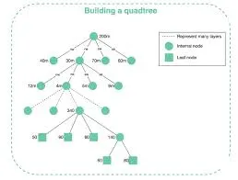
The Incremental Construction method also uses a DCEL, supported by a point-location structure such as a quadtree to identify where each new point should be inserted.
A quadtree is a tree that stores 2D spatial data by repeatedly dividing the area into four regions. Only regions that contain points become nodes in the tree,
allowing efficient searching by recursively splitting space and ignoring empty areas.

Slide 31
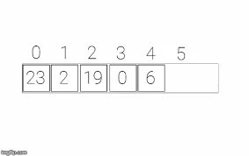
Finally, the Brute-Force Half-Plane Intersection approach uses very simple structures, mainly lists of vertices to represent polygons that get clipped repeatedly by half-planes.

Slide 32
SPACE COMPLIXITY

Slide 33
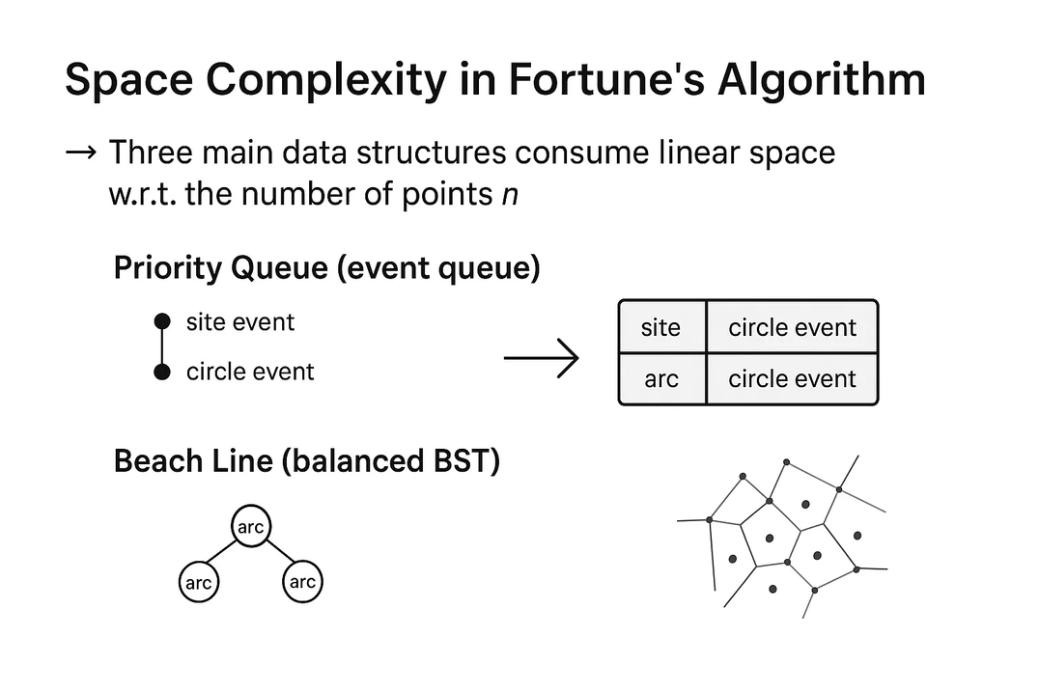
Space Complexity in Fortune’s Algorithm
Fortune’s Algorithm relies on three main data structures during execution, and each one requires linear space with respect to the number of input points n:
Priority Queue (Event Queue)
Beach Line (Balanced Binary Search Tree)
Voronoi Diagram Data (Edges and Vertices)

Slide 34
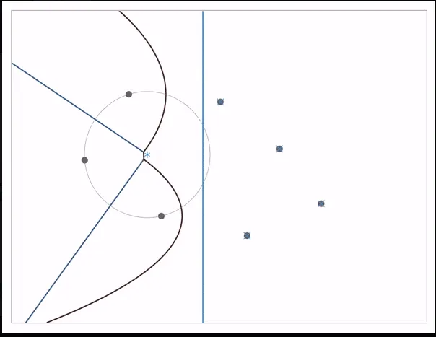
1. Priority Queue (Event Queue)
The algorithm uses a priority queue to store two types of events:
Site events
Circle events
The total number of events is O(n):
each point contributes exactly one site event, and the number of circle events is also bounded linearly.
Since each event is stored as a single record in the queue, the space required for the event queue is O(n).

Slide 35

2. Beach Line (Balanced Binary Search Tree)
The beach line represents a dynamic structure of parabolic arcs and is implemented as a balanced binary search tree.
At any moment during execution, the beach line contains at most O(n) arcs, because each arc is associated with a site or a combination of events.
Each arc node stores a small, constant amount of information (pointers, a site reference, and circle-event flags).
Therefore, the total memory used for the beach line is O(n)

Slide 36
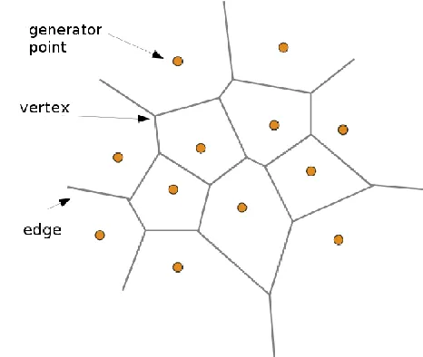
3. Voronoi Diagram Data (Edges and Vertices)
As the algorithm runs, it constructs the final Voronoi diagram, which consists of edges and vertices.
For any set of n points, the resulting diagram contains O(n) edges and vertices.
Since each edge or vertex is created only once and stores a constant amount of data, the space required for the Voronoi output is also O(n)

Slide 37
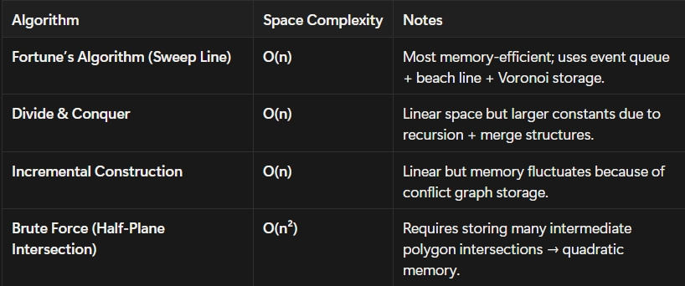
Why Fortune’s Algorithm is the most efficient one in space complexity?

Slide 38
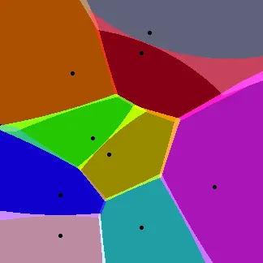
Conclusion
When we combine the memory usage of the priority queue, the beach line, and the Voronoi diagram data (edges and vertices), we find that:
Space Complexity = O(n)
This means that Fortune’s Algorithm is highly memory-efficient, since all the data structures it uses grow linearly with the number of input points.
This linear space requirement is one of the reasons the algorithm is considered powerful and efficient for constructing Voronoi diagrams quickly and effectively.

Slide 39
TIME COMPLIXITY

Slide 40
Time Complexity = O(n) * O(log n)
1. Source of the Linear Factor: O(n)
The analysis of Fortune's Algorithm begins by understanding the source of the linear factor, O(n). This factor represents the total number of operations carried out by the algorithm, which scales linearly with the number of input sites, n. The algorithm uses the Sweep Line technique, and all events and structural changes are linearly bounded by n:
• Site Events: These events, which occur for every input point, are exactly n in number.
• Circle Events: These events, which finalize the Voronoi vertices, are also bounded by O(n) (specifically 2n - 5).
• Beach Line Arcs: The number of parabolic arcs that constitute the Beach Line at any given moment does not exceed O(n). Conclusion: Since the total count of elementary operations (insertions, deletions, modifications) performed on the underlying data structures is O(n), this forms the first, crucial part of the overall complexity equation.

Slide 41
2. Source of the Logarithmic Factor: O(log n) and Final Complexity O(n log n)
The O(log n) factor is tied to the efficiency of executing each individual operation. To ensure the algorithm is Optimal, every search, insertion, or deletion must take only O(log n) time. This efficiency is achieved through the strategic use of two highly-efficient, balanced data structures:
A. Event Queue
• Function: Orders and manages all future events chronologically.
• Complexity: Typically implemented as a Binary Heap or Balanced BST. This structure guarantees that inserting or removing any event costs only O(log n) time.
B. Beach Line
• Function: Dynamically maintains the ordered set of parabolic arcs representing the current boundaries
• Complexity: Implemented as a Balanced BST. This ensures that operations like searching for an arc, splitting an arc, or deleting an arc (required during Site Events or Circle Events) also cost O(log n).

Slide 42
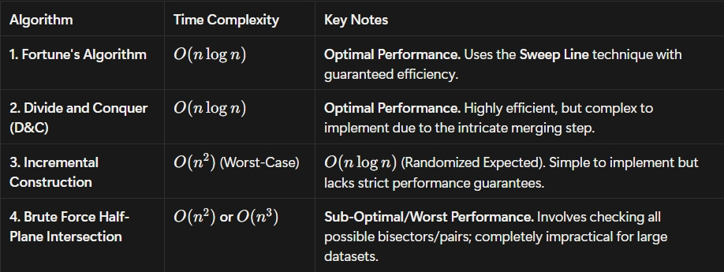
TIME COMPLEXITY COMPARISON OF VORONOI ALGORITHMS

Slide 43
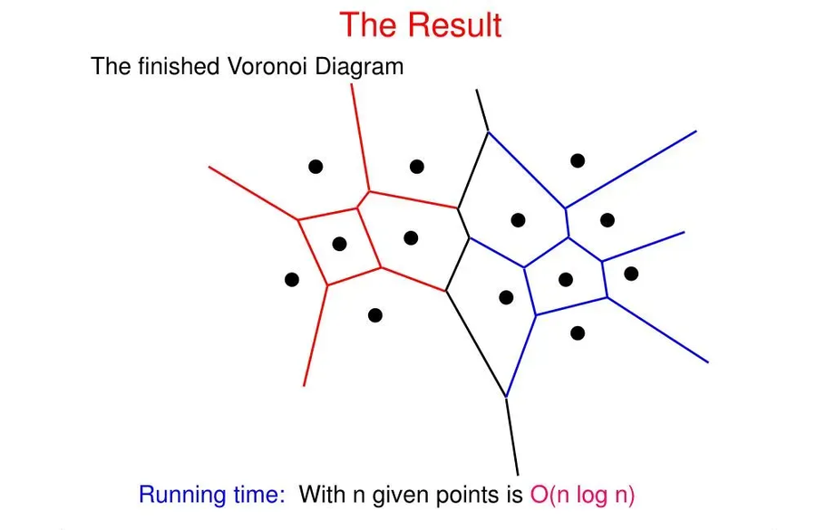
Overall Conclusion:
By combining these factors, the time complexity is determined by the multiplication principle:
Total Complexity = O(Operations) * O(Cost per Operation)
O(n log n) = O(n)*O(log n)
This combination makes Fortune's Algorithm achieve the optimal time complexity of O(n log n)for constructing Voronoi Diagrams.

Slide 44
Why Fortune’s Algorithm is the Best Fortune’s Algorithm is superior both theoretically and practically because it:
✔ Uses a Sweep Line technique
✔ Avoids expensive geometric operations
✔ Handles events efficiently using well-structured data
✔ Achieves the optimal Time Complexity which is the lowest possible time for Voronoi construction.

Slide 45
FORTUNE’S PLANE SWEEP IMPLEMENTATION.

Slide 46

A Python implementation of the Fortune’s algorithm based on the description of “Computational Geometry: Algorithms and Applications” from page 145 to
Algorithm.py
Input: list of points sites
Output: Voronoi diagram “edges & vertices”

Slide 47
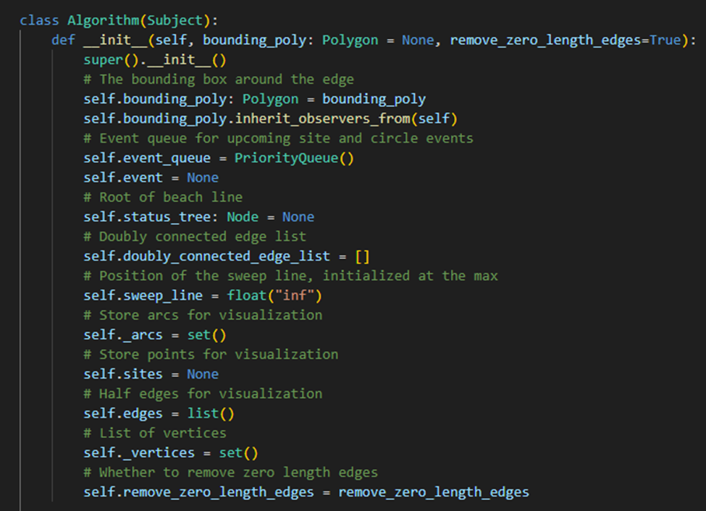
constractor has :
Parameters
bounding_poly: Polygon
The bounding box around the voronoi diagram to avoid infinite edges
remove_zero_length_edges: bool
Removes zero length edges and combines vertices with the same location into one

Slide 48
Attributes
bounding_poly: Polygon
The bounding box (or polygon) around the edge
event_queue: PriorityQueue
Event queue for upcoming site and circle events
status_tree: Node

Slide 49
The status structure is a data structure that stores the relevant situation at the current position of the sweep line.
This attribute points to the root of the balanced binary search tree that functions as a
status structure which represents the beach line as a balanced binary search tree.
sweep_line: Decimal
The y-coordinate
arcs: list(:class:`foronoi.nodes.Arc`)
List of arcs
sites: list(:class:`foronoi.graph.Point`)
List of points
vertices: list(:class:`foronoi.graph.Vertex`)
List of vertices

Slide 50
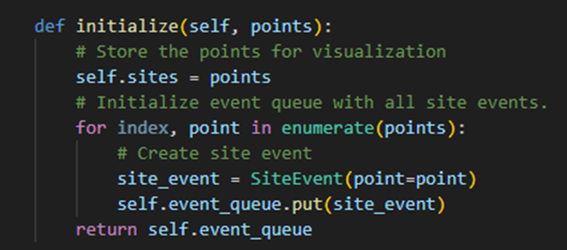
Initialize the event queue `event_queue` with all site events.
Parameters
points: list(Point)
The list of cell points to initialize
Returns
event_queue: PriorityQueue
Event queue for upcoming site and circle events

Slide 51
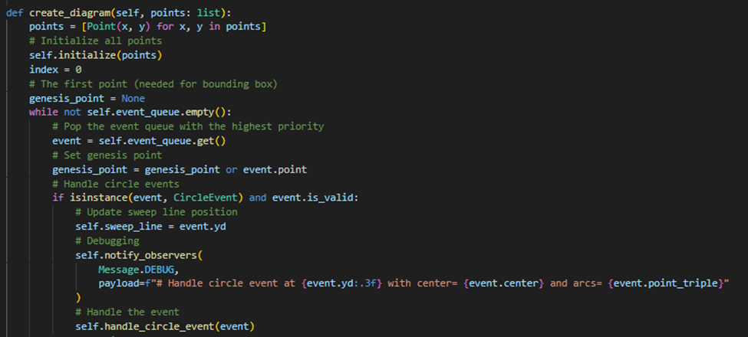

Slide 52
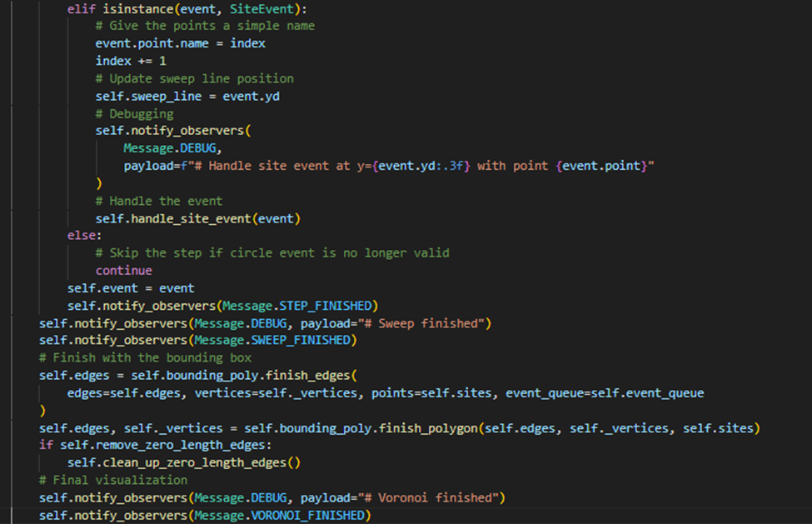
Create the Voronoi diagram.
Parameters
----------
points: list(Point)
A set of point sites in the plane.
Returns
-------
Output. The Voronoi diagram `Vor(P)`
given inside a bounding box
in a doublyconnected edge list `D`.

Slide 53
The overall structure of the algorithm is as follows.
1. Initialize the event queue `event_queue` with all site events,
initialize an empty status structure `status_tree` and an empty doubly-connected edge list `D`.
2. while `event_queue` is not empty do
Remove the event with largest `y`-coordinate from `event_queue`.
if the event is a site event, occurring at site `point`
then : func: handle_site_event`else : func: handle_circle_event`
3. The internal nodes still present in `status_tree` correspond to the half-infinite edges of the Voronoi diagram.
Compute a bounding box (or polygon) that contains all vertices of bounding box
by updating the doubly-connected edge list appropriately.
4. If `remove_zero_length_edges` is true.
Call :func:`~clean_up_zero_length_edges` which removes zero
length edges and combines vertices with the same location into one.

Slide 54
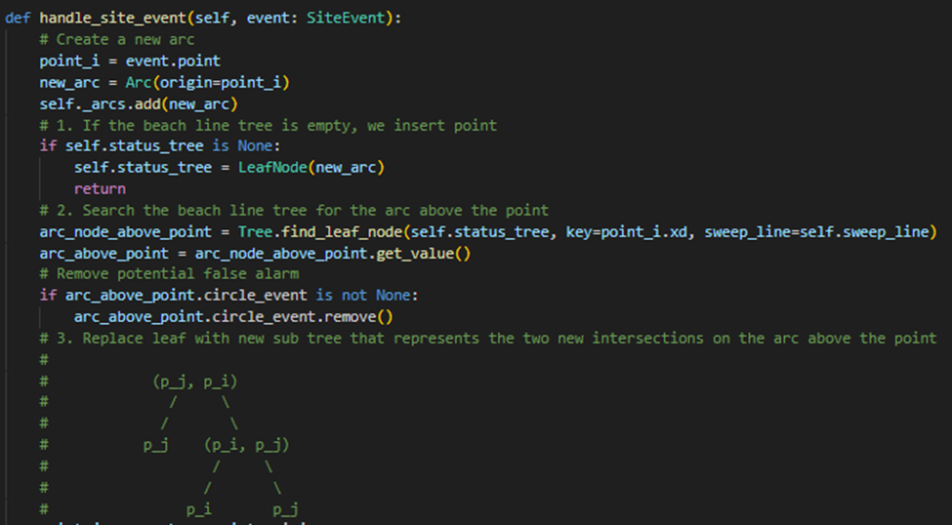
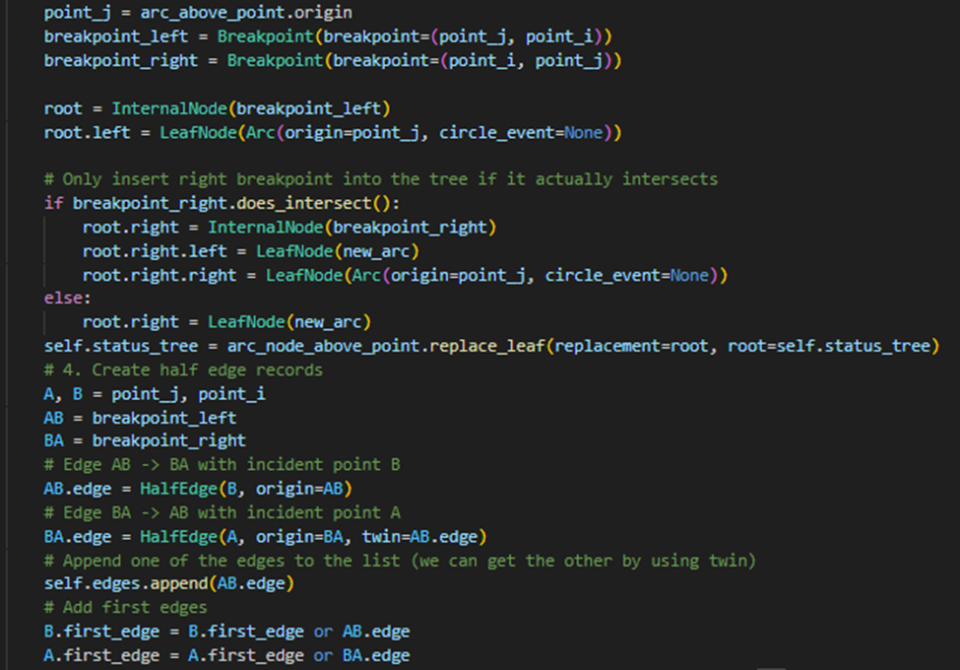

Slide 55
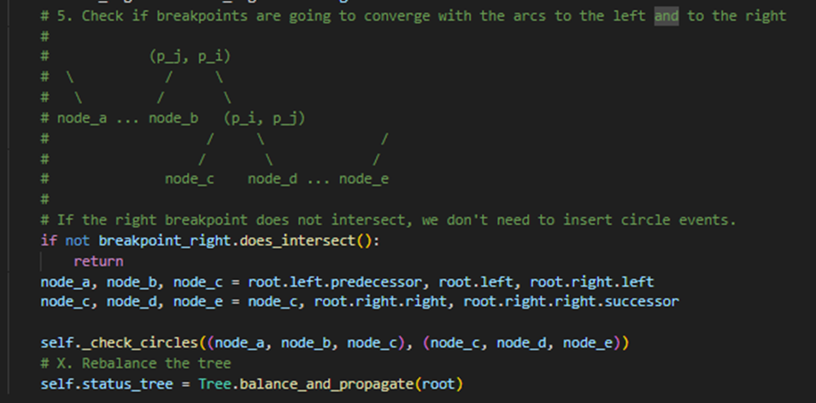
Handle a site event.
Parameters
----------
event: SiteEvent
The site event to handle.
1. Let :obj:`point_i = event.point`. If :attr:`status_tree` is empty, insert :obj:`point_i` into it (so that
:attr:`status_tree` consists of a single leaf storing :obj:`point_i`) and return. Otherwise, continue with
steps 2– 5.
2. Search in :attr:`status_tree` for the arc :obj:`α` vertically above :obj:`point_i`. If the leaf
representing :obj:`α` has a pointer to a circle event in :attr:`event_queue`, then this circle event is a
false alarm and it must be deleted from :attr:`status_tree`.

Slide 56
3. Replace the leaf of :attr:`status_tree` that represents :obj:`α` with a subtree having three leaves.
The middle leaf stores the new site :obj:`point_i` and the other two leaves store the site
:obj:`point_j` that was originally stored with :obj:`α`. Store the breakpoints
(:obj:`point_j`, :obj:`point_i`) and (:obj:`point_i`, :obj:`point_j`) representing the new breakpoints at the
two new internal nodes. Perform rebalancing operations on :attr:`status_tree` if necessary.
4. Create new half-edge records in the Voronoi diagram structure for the
edge separating the faces for :obj:`point_i` and :obj:`point_j`, which will be traced out by the two new
breakpoints.
5. Check the triple of consecutive arcs where the new arc for pi is the left arc
to see if the breakpoints converge. If so, insert the circle event into :attr:`status_tree` and
add pointers between the node in :attr:`status_tree` and the node in :attr:`event_queue`. Do the same for the
triple where the new arc is the right arc.

Slide 57
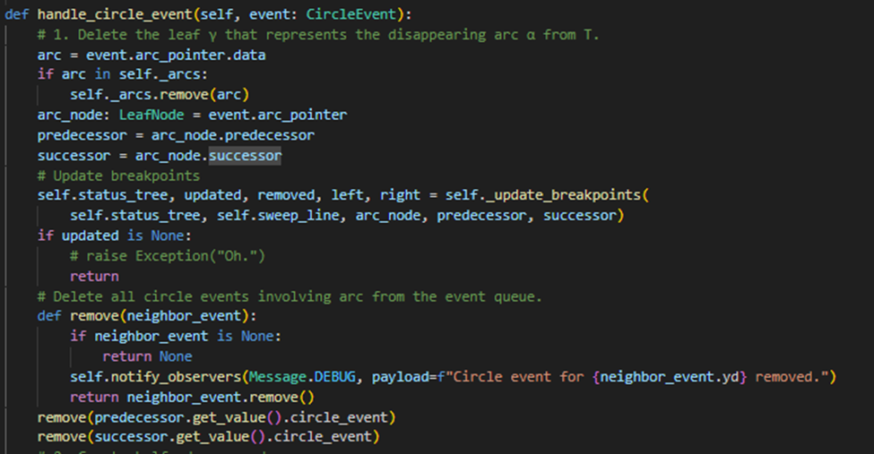
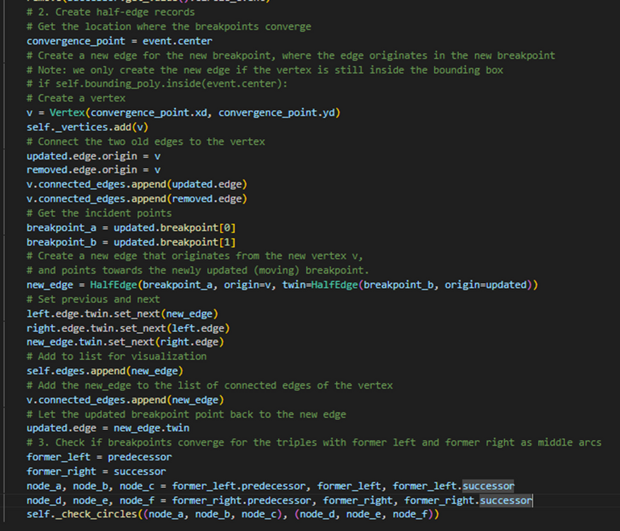
Handle a circle event.
Parameters
event
Returns

Slide 58
1. Delete the leaf :obj:`γ` that represents the disappearing arc :obj:`α` from :attr:`status_tree`. Update
the tuples representing the breakpoints at the internal nodes. Perform
rebalancing operations on :attr:`status_tree` if necessary. Delete all circle events involving
:obj:`α` from :attr:`event_queue`; these can be found using the pointers from the predecessor and
the successor of :obj:`γ` in :attr:`status_tree`. (The circle event where :obj:`α` is the middle arc is
currently being handled, and has already been deleted from :attr:`event_queue`.)
2. Add the center of the circle causing the event as a vertex record to the
doubly-connected edge list :obj:`D` storing the Voronoi diagram under construction. Create two half-edge
records corresponding to the new breakpoint
of the beach line. Set the pointers between them appropriately. Attach the
three new records to the half-edge records that end at the vertex.
3. Check the new triple of consecutive arcs that has the former left neighbor
of :obj:`α` as its middle arc to see if the two breakpoints of the triple converge.
If so, insert the corresponding circle event into :attr:`event_queue`. and set pointers between
the new circle event in :attr:`event_queue` and the corresponding leaf of :attr:`status_tree`. Do the same
for the triple where the former right neighbor is the middle arc.

Slide 59
Parameters
----------
triple_left: tuple(LeafNode, LeafNode, LeafNode)
Three consecutive arcs on the left side of a
disappearing or inserted arc.
triple_right: tuple(LeafNode, LeafNode, LeafNode)
Three consecutive arcs on the right side
of a disappearing or inserted arc.
Returns
-------
left_event: CircleEvent or None
The circle event created from the left triple, if any.
right_event: CircleEvent or None
The circle event created from the right triple, if any.
Check for potential circle events given two triples of consecutive arcs on the beach line.

Slide 60
1. For each triple (left and right), attempt to create a circle event using the three arcs.
2. Verify that the circle formed by the triple has the correct clockwise orientation. If not, discard it.
3. If valid, insert the circle event into the event queue and store a pointer in the middle arc.
4. Notify observers (debugging) about any created circle events

Slide 61
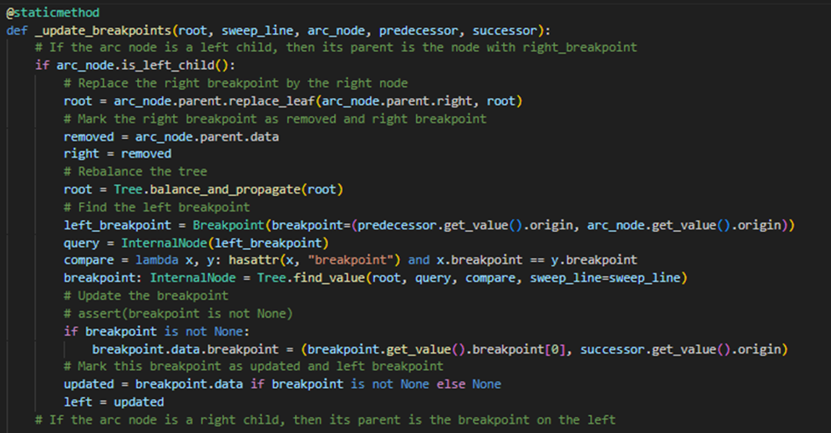
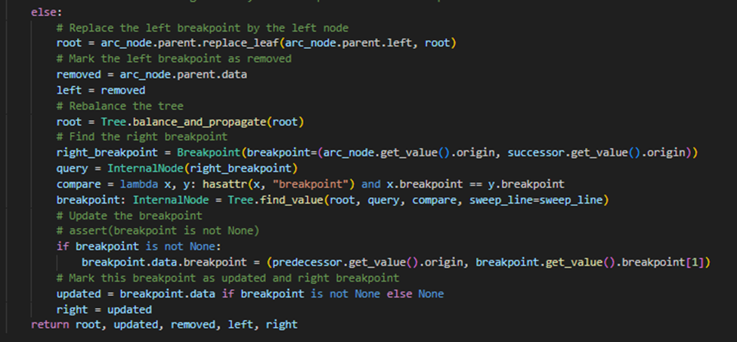

Slide 62
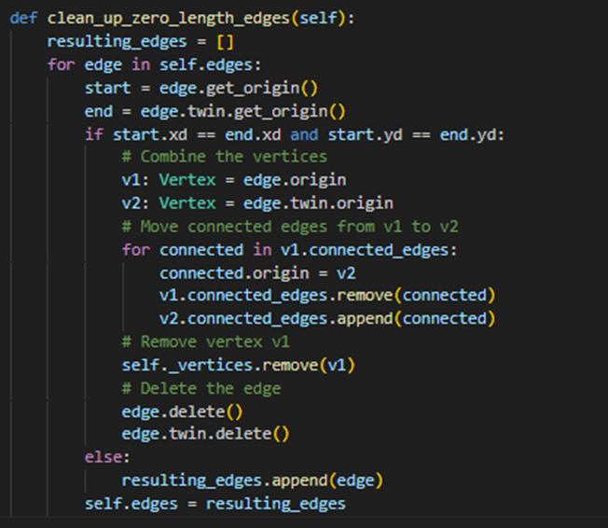
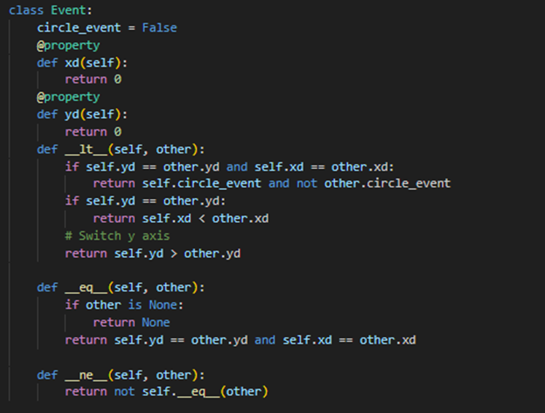
Removes zero length edges and vertices with the same coordinate
that are produced when two site-events happen at the same time
events.py

Slide 63
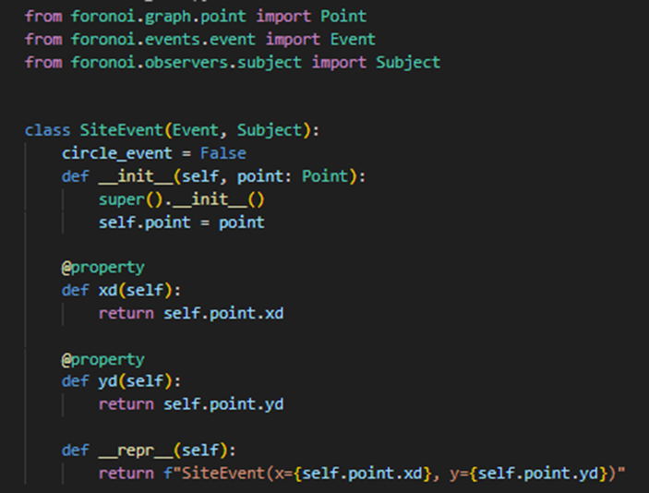
A site event used in Fortune's algorithm.
A site event is generated for each input
point and represents the moment
when the sweep line reaches that point.
When processed, a new arc is
inserted into the beach line
at the corresponding y-coordinate of the point.

Slide 64
Parameters
point : Point
The input point that triggers this site event.
The x-coordinate (Decimal) of the point.
This value is used as the secondary priority when ordering events in
the event queue
Returns
Decimal
The x-coordinate of the site associated with this event.
The y-coordinate (Decimal) of the point.
This value is used as the primary priority when ordering events in the
event queue (events with larger y-values are processed first).
Returns
Decimal
The y-coordinate of the site associated with this event.

Slide 65
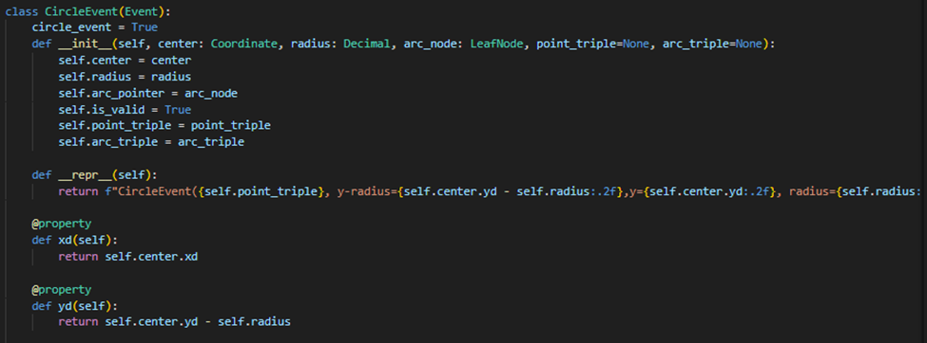
Circle_event.py
A circle event.
Parameters
----------
center: Coordinate
The center coordinate of the circle
(where the new vertex will appear)
radius: Decimal
The radius of the circle
arc_node: LeafNode
Pointer to the node in the beach line tree that holds the arc that will disappear
point_triple: (Point, Point, Point)
The triple of points that caused the event
arc_triple: (Arc, Arc, Arc)
The triple of arcs related to the points
The x-coordinate (in Decimal format) of the center of the circle, which functions as the secondary priority of this event.

Slide 66
Returns
x: Decimal
The y-coordinate (in Decimal format) of the bottom of the circle,
which functions as the primary priority of this event.
Returns
y: Decimal

Slide 67
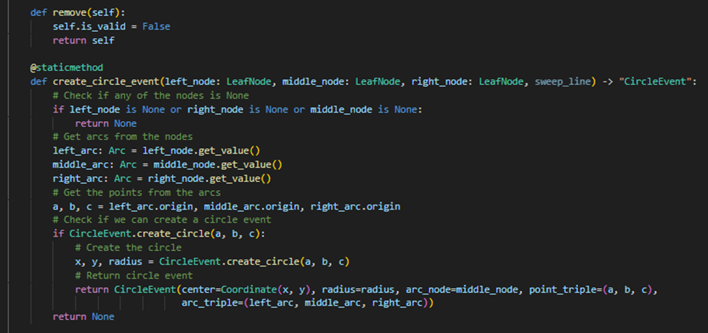
Mark this circle
event as a false alarm.
Returns
self: CircleEvent
Checks if the breakpoints converge,
and inserts circle event if required

Slide 68
Parameters
----------
left_node: LeafNode
The node that represents the arc on the left
middle_node: LeafNode
The node that represents the arc in the middle
right_node: LeafNode
The node that represents the arc on the right
sweep_line: Decimal
The y-coordinate of the sweep line
Returns
-------
circleEvent: CircleEvent or None
The circle event or None if no circle event needs to be inserted

Slide 69
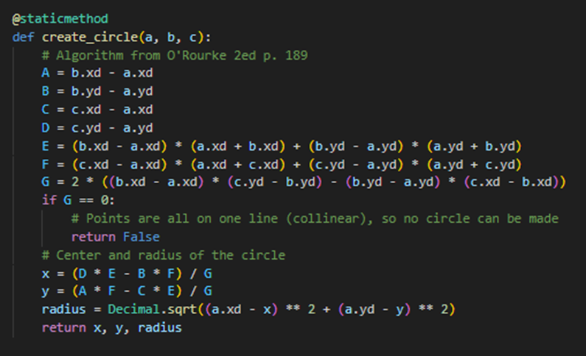
Create a circle from three coordinates.
Parameters
a: Coordinate
b: Coordinate
c: Coordinate
Returns
-------
x: Decimal
The x-coordinate of the center of the circle
y: Decimal
The y-coordinate of the center of the circle
radius: Decimal
The radius of the circle

Slide 70
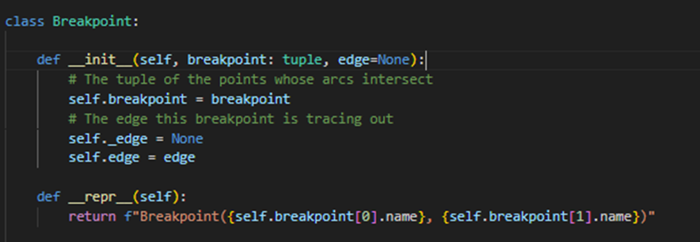
Breackpoint.py
A breakpoint between two arcs.
The breakpoint is stored by an ordered tuple of sites (:obj:`p_i`, :obj:`p_j`) where :obj:`p_i` defines the
parabola left of the breakpoint and :obj:`p_j` defines the parabola to the right. Furthermore, the internal node
:obj:`v` has a pointer to the half edge in the doubly connected edge list of the Voronoi diagram. More
precisely, :obj:`v` has a pointer to one of the half-edges of the edge being traced out by the breakpoint
represented by :obj:`v`.

Slide 71
Parameters
----------
breakpoint: (Point, Point)
A point where two arcs intersect,
represented as a tuple of the two site points that the arcs refer to

Slide 72
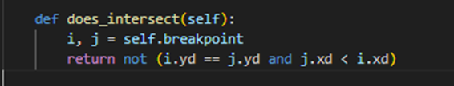
A guard that handles the edge-case where two arcs were initialized at the same time due to their sites
having the same :obj:`y`-coordinate. This guard makes sure that the left arc intersects
once with the right arc
and not the other way around.
Returns
-------
intersects: bool
Returns false when :obj:`p_i` and :obj:`p_j` have the same y-coordinate and :obj:`p_j` is
situated left of `p_i`.

Slide 73
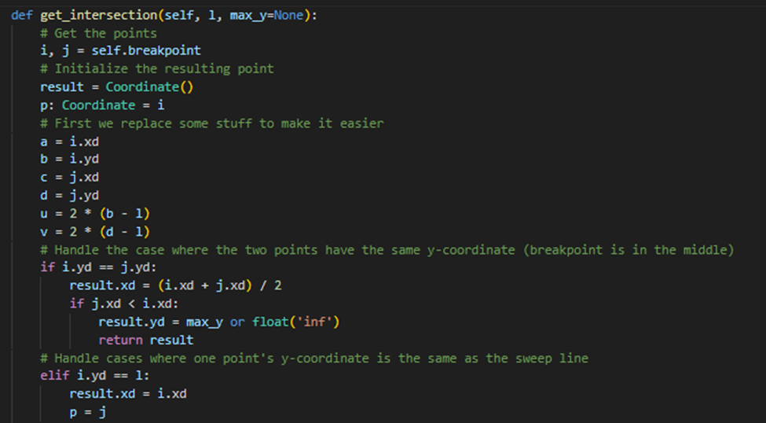
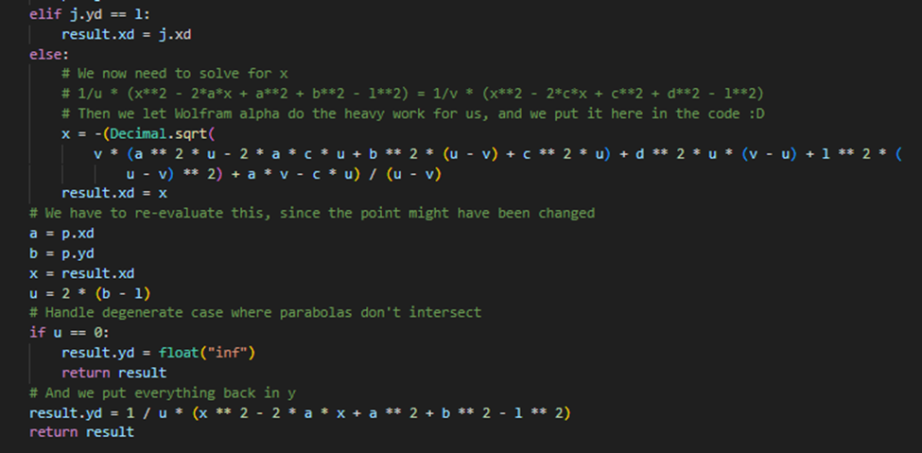
Calculate the coordinates of the intersection
Modified from https://www.cs.hmc.edu/~mbrubeck/voronoi.html

Slide 74
Parameters
l: float
The y-coordinate of the sweep line
max_y: float
The top of the bounding box/polygon for clipping infinite breakpoints
Returns
coordinate: Coordinate
The current coordinates of the breakpoint

Slide 75
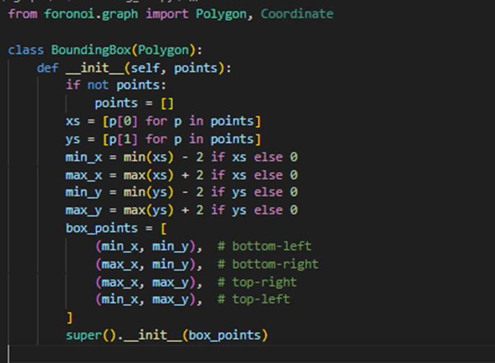
Bounding_box.py
Convenience class to create a bounding box around a set of points.
Extends :class:`foronoi.graph.Polygon`.
Parameters
----------
points: list of tuples [(x1, y1), (x2, y2), ...]
The points that will be enclosed by the bounding box.

Slide 76

Points.py
A cell point a.k.a. a site. Extends the :class:`Coordinate` class.

Slide 77
Examples
Site operations
>>> size: float = site.area() # The area of the cell
>>> borders: List[HalfEdge] = site.borders() # Borders around this cell point
>>> vertices: List[Vertex] = site.vertices() # Vertices around this cell point
>>> site_x: float = site.x # X-coordinate of the site
>>> site_xy: [float, float] = site.xy # (x, y)-coordinates of the site
>>> first_edge: HalfEdge = site.first_edge # First edge of the site's border

Slide 78
Parameters
x: Decimal
The x-coordinate of the point
y: Decimal
They y-coordinate of the point
metadata: dict
Optional metadata stored in a dictionary
name: str
A name to easily identify this point
first_edge: HalfEdge
Pointer to the first edge
Attributes
name: str
A name to easily identify this point
first_edge: HalfEdge
Pointer to the first edge

Slide 79

Calculate the cell size of the cell that this point is the cell point of.
Under the hood, the shoelace algorithm is used.
Parameters
----------
digits: int
The number of digits to round to
Returns
-------
area: float
The area of the cell

Slide 80

Get a list of all the vertices that surround this cell point.
Returns
-------
vertices: list(Vertex) or None
The list of vertices, or None if not all borders are present (when the voronoi diagram is under
construction)

Slide 81

A bounding polygon that will clip the edges and fit around the Voronoi diagram.
Parameters
----------
tuples: list[(float, float)]
x,y-coordinates of the polygon's vertices

Slide 82



Slide 83


Slide 84
Creates half-edges on the bounding polygon that link with Voronoi diagram's half-edges and existing vertices.
Parameters
----------
edges: list(HalfEdge)
The list of clipped edges from the Voronoi diagram
existing_vertices: set(Vertex)
The list of vertices that already exists in the clipped Voronoi diagram, and vertices
points: set(Point)
The list of cell points
Returns
-------
edges: list(HalfEdge)
The list of all edges including the bounding polygon's edges
vertices: list(Vertex)
The list of all vertices including the

Slide 85

Clip the edges to the bounding box/polygon, and remove edges and vertices that are fully outside.
Inserts vertices at the clipped edges' endings
Parameters
edges: list(HalfEdge)
A list of edges in the Voronoi diagram.
Every edge should be presented only by one half edge.
Returns
clipped_edges: list(HalfEdge)
A list of clipped edges

Slide 86



Slide 87

Tests whether a point is inside a polygon.
Based on the Javascript implementation from https://github.com/substack/point-in-polygon
Parameters
point: Point
The point for which to check if it it is inside the polygon
Returns
inside: bool
Whether the point is inside or not

Slide 88


Slide 89
Edges are normally treated as undirected and shared between faces. However, for some tasks (such as simplifying
or cleaning geometry) it is useful to view faces as each having their own edges.
You can think of this as splitting each shared undirected edge along its length into two half edges.
(Boundary edges of course will only have one "half-edge".)
Each half-edge is directed (it has a start vertex and an end vertex).
The half-edge properties let you quickly find a half-edge’s source and destination vertex, the next half-edge,
get the other half-edge from the same edge, find all half-edges sharing a given point, and other manipulations.

Slide 90
Examples
Get the half-edge's source
>>> edge.origin
Get the half-edge's destination
>>> edge.target # or edge.twin.origin
Get the previous and next half-edge
>>> edge.prev
>>> edge.next
Get the other half-edge from the same edge
>>> edge.twin
Find all half-edges sharing a given point
>>> edge.origin.connected_edges

Slide 91
Parameters
incident_point: Point
The cell point of which this edge is the border
twin: HalfEdge
The other half-edge from the same edge
origin: Breakpoint or Vertex
The origin of the half edge. Can be a Breakpoint or a Vertex during construction, and only Vertex when
the diagram is finished.
Attributes
origin: :class:`Breakpoint` or :class:`Vertex`
Pointer to the origin. Can be breakpoint or vertex.
next: :class:`HalfEdge`
Pointer to the next edge
prev: :class:`HalfEdge`
Pointer to the previous edge

Slide 92

Update the `next`-property for this edge and set the `prev`-property on the `next`-edge to the current edge
Parameters
----------
next: HalfEdge
The next edge

Slide 93

Get the coordinates of the edge's origin.
During construction of the Voronoi diagram, the origin can be a vertex, which has a fixed location, or a
breakpoint, which is a breakpoint between two moving arcs. In the latter case, we need to calculate the
position based on the `y`-coordinate of the sweep line.
Parameters
----------
y: Decimal
The y-coordinate of the sweep line.
max_y:
Bounding box top for clipping infinitely highly positioned breakpoints.
Returns
origin: Coordinate

Slide 94


Get the other half-edge from the same edge
Returns
-------
twin: HalfEdge
The twin's origin.
Returns
-------
vertex: Vertex

Slide 95

Delete this half edge by pointing the previous edge to the next, and removing it from the origin's
connected edges list

Slide 96

Vertex.py
A vertex is a fixed cross point between borders. Extends the :class:`Coordinate` class.
Examples
Vertex operations
>>> connected_edges: List[HalfEdge] = vertex.connected_edges # All connected edges
>>> vertex_x: float = vertex.x # x-coordinate
>>> vertex_xy: [float, float] = vertex.xy # (x, y)-coordinates
Parameters
x: Decimal
x-coordinate
y: Decimal
y-coordinate
connected_edges: list(:class:`HalfEdge`)
List of edges connected to this vertex.
Attribute
connected_edges: list(:class:`HalfEdge`)
List of edges connected to this vertex.

Slide 97

Arc.py
Each leaf of beach line, representing an arc `α`,
stores one pointer to a node in the event queue, namely, the
node that represents the circle event in which `α` will disappear.
This pointer is None if no circle event
exists where `α` will disappear,
or this circle event has not been detected yet.

Slide 98
Parameters
origin: Point
The point that caused the arc
circle_event: CircleEvent
The pointer to the circle event in which the arc will disappear
Attributes
----------
origin: Point
The point that caused the arc
circle_event: CircleEvent
The pointer to the circle event in which the arc will disappear

Slide 99

Computes all `y`-coordinates for given `x`-coordinates and the sweep line's `y`-coordinate.
Parameters
----------
x: np.array
The input x-coordinates
sweep_line: Decimal, float
The y-coordinate of the sweep line
Returns
y: number, array-like
A list of y-values

Slide 100

Half_edges.py

Slide 101
TREE AND NODE

Slide 102


Find an item using a query node and a comparison function.
:param root: (Node) The root to start searching from
:param query: The query
:param compare: (lambda) Lambda expression to compare the node against the query. Will be called as
compare(node.data, query.data).
:param kwargs: Optional arguments to be passed to the get_key() functions
:return: (Node or None) Returns the node that corresponds to the query or None

Slide 103

Follows a path downward between the internal nodes
using the key until it
reaches a leaf node. If it is unclear which path to take, the left path is
taken.
:param root: (Node) The root of the (sub)tree to travel down
:param key: The key to use to determine the path
:param kwargs: Optional arguments passed to the get_key() functions
:return: (Node) The node found at the end of the journey

Slide 104



Walks up the tree recursively to rebalance all nodes, until it reaches the new root.
:param node: The starting point, everything below this point is assumed to be balanced.
:return: The root of the balanced tree

Slide 105


Rotate tree to the left.
:param z: (Node) The root of the sub tree
:return: (Node) The new root of the sub tree
Make the three balanced if it is unbalanced.
:param node: (Node) The root node of the tree to balance
:return: (Node) The new root of the sub tree

Slide 106


Rotate tree to the right.
:param z: (Node) The root of the sub tree
:return: (Node) The new root of the sub tree

Slide 107


Internal_node.py
Leaf_node.py

Slide 108

Node
A smart tree node with some extra functionality over standard nodes.
:param data: Data that is stored inside the node.

Slide 109









Slide 110



Recursively calculate height of this node.
Height calculated for each node will be stored, so calculations need to be done only once.
:return: (int) Height of the current node

Slide 111


Recalculate the heights of this node and all ancestor nodes.
Recalculate the height of the node.

Slide 112



Determines whether this node is a left child.
:return: (bool) True if this node is a left child, False otherwise
Determines whether this node is a leaf.
:return: (bool) True if this node is a leaf, False otherwise
Determines whether this node is a right child.
:return: (bool) True if this node is a right child, False otherwise

Slide 113


Determines the node with the smallest key in the subtree rooted by this node.
:return: (Node) Node with the smallest key
Determines the node with the largest key in the subtree rooted by this node.
:return: (Node) Node with the largest key

Slide 114

Returns the node with the smallest key larger than this node's key, or None
if this node has the largest key in the tree.

Slide 115

Returns the node with the largest key smaller than this node's key, or None
if this node has the smallest key in the tree.

Slide 116

Replace the node by a replacement tree.
Requires the current node to be a leaf.
:param replacement: (Node) The root node of the replacement sub tree
:param root: (Node) The root of the tree
:return: (Node) The root of the updated tree

Slide 117


Visualize the node and its descendants.
:param depth: (int) Used by the recursive formula, should be left at the default value
:return: (str) String representation of the visualization

Slide 118
OUTPUT TRACE

Slide 119
Introduction
We have four sites, ordered by decreasing y-value (because the sweep line moves downward).
Indices follow the same ordering used in your images:
index 0 → P0 = (7,6)
index 1 → P1 = (4,5)
index 2 → P2 = (1,3)
index 3 → P3 = (8,2)
To compute breakpoints, we use the directrix (the y-position of the sweep line) slightly below the y-coordinate of the site being inserted:
d = y_site − ε
This is necessary because if we use d = y_site, the parabola formula becomes undefined (division by zero).
So all numeric results below are computed as a limit, using a directrix just below the site.

Slide 120
Parabola Formula (used repeatedly)
For a site point ( P=(x_i, y_i) ) and a directrix ( y = d ) with ( d < y_i ):
[
y = \frac{(x-x_i)^2 + y_i^2 - d^2}{2(y_i - d)}
]
A breakpoint between two sites (P_a) and (P_b) is found by solving:
[ \text{Parabola}_a(x) = \text{Parabola}_b(x) ]
This gives two roots; only the root consistent with the left-to-right structure of the beachline is used.
A circle event is determined by the circumcircle of three consecutive sites.
The circle event happens when the sweep line reaches:
[y_{event} = u_y - r]
where ((u_x,u_y)) is the center and (r) is the radius.

Slide 121

Parabola Formula (used repeatedly)
A breakpoint between two sites aP and bP is found by solving
Parabolab​(x)=Parabolaa​(x)
This gives two roots; only the root consistent with the left-to-right structure of the beachline is used
A circle event is determined by the circumcircle of three consecutive sites
the circle event happens when the sweep line reaches:
r−yu​=eventy
where (yu,xu)(y_u, x_u)(yu​,xu​) is the center and rrr is the radius

Slide 122

Slide 0 — Initial State
State:
No SiteEvents have occurred.
The tree is empty — no arcs, no breakpoints, no parabolas.
Nothing to compute here.

Slide 123

Slide 1 — First Site Event: P0 = (7,6)
Directrix: ( d \to 6^- )
After inserting the first site, there is only one arc.
Tree:
A single leaf holding the value:
0
No breakpoints exist because there is only one parabola

Slide 124

Slide 2 — Insert P1 = (4,5)
Directrix: ( d \to 5^- )
Computing Breakpoint BP(0,1)
Solving the parabola intersection gives two x-roots:
( x \approx 3.89695 )
( x \approx 4.09705 )
We choose the second one because it lies
between the x-positions of P1 (4) and P0 (7).
Valid breakpoint:
[
x \approx 4.09705
]
Tree After Insertion:
Arc 0 splits into: left-0, new-1, right-0
A new internal node (0,1) is created
This matches the beachline 0–1–0 in the picture.

Slide 125

Slide 3 — Insert P2 = (1,3)
Directrix: ( d \to 3^- )
P2 is far to the left, so it splits
the leftmost arc (which is arc 0).
Computing Breakpoints:
1) BP(0,1):Roots:−9.7522
5.7462 ← valid one
2) BP(1,2):Roots:0.91786
1.07914 ← valid
3) BP(0,2):Roots:0.8755
1.1205 ← valid (for left-side geometry)
Only the roots that respect the correct left-to-right order become actual breakpoints.
Geometric Meaning:
P2 cuts the left part of arc 0, creating:
0 → 0, 2, 0
This introduces new breakpoints (0,2) and (1,2), and the new top node becomes (2,1).

Slide 126

Slide 4 — Insert P3 = (8,2)
Directrix: ( d \to 2^- )
P3 appears on the far right, so it splits the rightmost arc, which is arc 0.
Compute BP(0,3):
Two roots; valid one:
[
x \approx 7.93505
]
Geometry now shows beachline order:
0 → 1 → 2 → 1 → 3 → 0

Slide 127
Circle Events (Full Math)
We now compute circumcircles of consecutive triplets to determine circle events.
Circle Event 1 — Triple (P1, P0, P3)
Points: (4,5), (7,6), (8,2)
Circle center:
[(u_x, u_y) \approx (6.11538,\ 3.65385)]
Radius:[r \approx 2.50739 ]
Circle event y-coordinate:
y_{event} = 3.65385 - 2.50739 \approx 1.14646]
This means:
➡️ When the sweep line reaches ( y = 1.14646 ),
the middle arc between these three sites collapses.
This matches the circle event shown in your images.

Slide 128
Circle Event 2 — Triple (P2, P1, P3)
Points: (1,3), (4,5), (8,2)
Center:
[(u_x, u_y) \approx (4.32353,\ 1.26471)]
Radius:[r \approx 3.74928]
Event y:[y_{event} \approx 1.26471 - 3.74928 \approx -2.48]
This event is below the bounding box,
so it does not appear in the diagram — but it exists mathematically.
Circle Event 3 — Triple (P2, P1, P0)
Event y is extremely low (negative),
so it does not affect the displayed Voronoi formation.

Slide 129
Circle Event 1 — Triple (P1, P0, P3)
Points: (4,5), (7,6), (8,2)
Circle center:
(3.65385 , 6.11538) ≈ (yᵤ, xᵤ)
Radius:
2.50739 ≈ r
Circle event y-coordinate:
1.14646 ≈ 2.50739 − 3.65385 = event_y
This means:
When the sweep line reaches y = 1.14646,
the middle arc between these three sites collapse

Slide 130

Slide 5 — Beachline After Circle Event
File: /mnt/data/combined_0005.png
Circle event occurred at:
[
d = y_{event} \approx 1.14646
]
The middle arc disappears,
so one leaf of the tree is removed,
and one internal node is replaced.
Meaning:
The beachline simplifies because three arcs meet in one shrinking circle.

Slide 131

Slide 6 — Final Voronoi Diagram
File: /mnt/data/combined_0006.png
After processing all SiteEvents and all CircleEvents,
the remaining breakpoints trace the final Voronoi diagram.
The final tree represents the final set of arcs and edges.
Breakpoints include values like:
4.097
5.746
1.079
7.935
etc.
These correspond to the intersection points of pairs of parabolas at different sweep-line positions.

Slide 132
FORTUNE’S PLANE SWEEP OUTPUT ANIMATION.

Slide 133


TreeVisualizer.py
TreeObserver.py
Observers the state of the status tree (:attr:foronoi.algorithm.Algorithm.status_tree) and visualizes
the result using GraphViz.
Parameters
----------
visualize_steps: bool
Visualize all individual steps
visualize_result: bool
Visualize the final result
text_based: bool
Visualize the tree using plain text instead of GraphViz
callback: function
By default, the TreeObserver renders and shows the result in a window, or prints the result when
text_based is true. When a callback function is given, either the GraphViz diagram or the text-string
is passed to the callback.

Slide 134
Examples
>>> from foronoi import Voronoi, TreeObserver, Polygon
>>> points = [
... (2.5, 2.5), (4, 7.5), (7.5, 2.5), (6, 7.5), (4, 4), (3, 3), (6, 3)
... ]
>>> poly = Polygon(
... [(2.5, 10), (5, 10), (10, 5), (10, 2.5), (5, 0), (2.5, 0), (0, 2.5), (0, 5)]
... )
>>> v = Voronoi(poly)
>>>
>>> # Define callback
>>> def callback(observer, dot):
... dot.render(f"output/tree/{observer.n_messages:02d}")
>>>
>>> # Attach observer
>>> v.attach_observer(TreeObserver(callback=callback))
>>>
>>> # Start diagram creation
>>> v.create_diagram(points)

Slide 135

Send the updated state of the algorithm to the TreeObserver.
Parameters
----------
subject: Algorithm
The algorithm to observe
message: Message
The message type

Slide 136

Description
Builds and visualizes a binary tree using Graphviz.
Recursively creates nodes and edges between
parents and children, then renders the tree as an
image.
Parameters
• node: TreeNode
The root of the tree to visualize.
• dot: Digraph (internal use) Visualizer.py
Graphviz object that stores nodes and edges.
• parent_id: str (internal use)
ID of the parent node to connect edges

Slide 137

Description
Defines visualization presets for different stages of the Voronoi diagram.
Each preset specifies which elements should be drawn.
Parameters / Attributes
• construction: dict
Shows polygon, events, beach line and sweep line.
• clipping: dict
Shows only polygon boundaries for clipping.
• final: dict
Shows final result with no construction artifacts

Slide 138

description
Generates a list of n random hex colors, avoiding colors that are too dark or too light
Randomness is controlled by a seed so results are repeatable
Parameters
• n: int
Number of colors to generate.
• seed: int
Controls randomness to produce deterministic output.
Returns
• list[str]
Hex color strings.

Slide 139

Visualizer
Visualizer which can also color each Voronoi cell.
Parameters
voronoi: Voronoi
The voronoi object
canvas_offset: float
The space around the bounding object
figsize: float, float
Width, height in inches
palette_seed: int
Seed used to generate a deterministic palette for site colors
Return list of n hex colors. Deterministic by seed.

Slide 140


Description
Sets the visible boundaries of the plot to match the computed minimum and maximum x/y values of the Voronoi diagram.
This ensures the whole diagram appears inside the canvas without clipping
Parameters
No parameters — uses class attribute
Attributes Used
• self.min_x, self.max_x
Horizontal bounds of the drawing area.
• self.min_y, self.max_y
Vertical bounds of the drawing area.
• canvas: Axes
The plotting surface where limits are applied
Returns
•self
For method chaining (allows writing multiple commands in a single call)

Slide 141

Retrieve the current matplotlib Figure.
Display all open figures (wrapper around matplotlib.pyplot.show).
Parameters:
block : bool, optional
If True, block and run the GUI main loop until all windows are closed.
If False, ensure that all windows are displayed and return immediately.
kwargs are forwarded to matplotlib.pyplot.show.

Slide 142

Build a deterministic palette mapping each
site to a color.
Description
Creates a color palette for the Voronoi sites if it has not been created before.Each site is assigned a unique color based on a generated palette. Behavior
• If the color map already exists → do nothing and return.
• Otherwise → generate colors and map each site to a specific color.
Parameters / Attributes Used
self.voronoi.sites
List of sites in the Voronoi diagram.
self._palette_seed
Ensures consistent color generation.
self._site_color_map: dict
Stores {site → color_hex} pairs.
Calls
build_palette(n, seed)
Generates n distinct colors.
Returns
None (implicitly)
Function only initializes the mapping.

Slide 143

Build a deterministic palette mapping each site to a color
description
Draws all components of the Voronoi diagram on the canvas.
Parameters
• polygon: bool
Draws the outer polygon if True.
• edges: bool
Draws all Voronoi edges if True.
• vertices: bool
Draws all Voronoi vertices if True.
• sites: bool
Draws all sites if True.
• cells: bool
Draws Voronoi cells if True.
• outgoing_edges: bool
Draws edges leaving each site if True.
• border_to_site: bool
Draws lines connecting borders to sites if True.

Slide 144
• scale: float , Scaling factor for outgoing edges.
• edge_labels: bool ,Displays labels for edges if True.
• site_labels: bool ,Displays labels for sites if True.
• triangles: bool , Draws triangles for events if True.
• arcs: bool , Draws arcs if True.
• sweep_line: bool ,Draws the sweep line if True.
• events: bool ,Draws events if True.
• arc_labels: bool ,Displays labels for arcs if True.
• beach_line: bool ,Draws the beach line if True.
Includes polygon, edges, vertices, sites, cells, sweep line, arcs, events, and beach line as selected

Slide 145

Description
Draws the bounding polygon of the Voronoi diagram.
If the bounding polygon has a radius, it draws a circle; otherwise, it draws a polygon.
Parameters
This method has no parameters.
It uses self.voronoi.bounding_poly to determine the shape to draw.
• Bounding shape: If bounding_poly has a radius, draws a circle; otherwise, draws the polygon using coordinates.
• Canvas: Adds the shape to self.canvas with no fill and edge color from Colors.BOUNDING_BOX

Slide 146

Description
Draws all Voronoi vertices on the canvas as scatter points.
Parameters
• vertices: list – List of vertices to draw; defaults to all Voronoi vertices (self.voronoi.vertices).
• kwargs: dict – Extra plotting arguments passed to the scatter function (e.g., marker size, alpha, etc.)

Slide 147

Description
Returns the start and end points of a Voronoi edge, taking into account its twin and the current sweep line.
Parameters
• edge: Edge – The Voronoi edge whose endpoints are calculated.
• sweep_line: float (optional) – The current sweep line position; defaults to None.
Attributes Used
• self.max_y – Maximum y-value of the plot, used to calculate edge endpoints.
• edge.twin – The twin edge corresponding to the given edge
Returns
• start, end: Coordinate, Coordinate – The start and end points of the edge

Slide 148

display the polygon outline
Description
Draws all Voronoi sites on the canvas with optional labels and individual colors.
Parameters
• points: list – List of sites to draw; defaults to all Voronoi sites (self.voronoi.sites).
• show_labels: bool – Display labels for sites if True.
• color: Color – Override color for all sites; if None, uses per-site palette.
• zorder: int – Z-order for plotting points (controls layer ordering)

Slide 149

Description
Draws all Voronoi edges on the canvas.
Also plots the corresponding twin edge.
Parameters
• edges: list
List of Voronoi edges to draw.
• sweep_line: float
The current sweep line position used during construction.
• show_labels: bool
Displays labels for edges if True.
• color: Color
Color of the drawn edges.
• kwargs: dict
Extra plotting arguments

Slide 150

Description
Draws helper lines connecting edge midpoints to the site points they originate from.
Parameters
• edges: list
Edges used to derive midpoints.
• sweep_line: float
Used to determine active edges

Slide 151

Description
Plots the arcs forming the beach line in Fortune’s algorithm.
Can optionally label the arcs or highlight them individually.
Parameters
• arcs: list
Collection of current arcs on the beach line.
• sweep_line: float
Determines the curvature of arcs.
• plot_arcs: bool
If True, draws detailed arc shapes.
• show_labels: bool
Whether to display arc labels

Slide 152

Description
Adds labels next to plotted arcs showing the corresponding site name.
Parameters
• x: ndarray
X coordinates used to compute arc points.
• plot_lines: list
Collection of computed y-values for arcs.
• bottom: ndarray
Lowest beach curve among plotted arcs.
• sweep_line: float
Needed for arc height calculation.
• arcs: list
Arcs to label

Slide 153

Description
Draws the sweep line used in Fortune’s algorithm.
Parameters
• sweep_line: float
Vertical line position representing the algorithm’s progress

Slide 154

Description
Displays a site/circle event during the Voronoi construction.
If the event is a circle event, the circle is drawn.
Parameters
• event: Event
The geometric event being processed.
• triangles: bool
Whether to draw the associated triangle

Slide 155

Description
Draws the circle that causes a circle event.
Optionally shows the triangle whose circumcircle defines the event.
Parameters
• evt: CircleEvent
Contains center, radius, and validity.
• show_triangle: bool
Displays the triangle of the event

Slide 156

Description
Draws a single Voronoi edge and optionally prints its label.
Parameters
• edge: Edge
Edge to draw.
• sweep_line: float
Helps determine visible endpoints.
• print_name: bool
Displays edge name near its midpoint.
• color: Color
Drawing color.
• kwargs: dict
Extra annotation options

Slide 157

Description
Draws a line from the midpoint of a Voronoi edge to its incident point.
If the edge is marked as the first edge of the incident point, the line is drawn with a special color.
Parameters
• edge: Edge – The Voronoi edge from which the midpoint is calculated.
• sweep_line: float (optional) – The current sweep line position used during edge construction; defaults to None.
Attributes Used
• edge.incident_point – The point associated with the edge where the line should end.
• incident_point.first_edge – Determines if this edge is the first connected edge to the incident point.
• self.canvas: Axes – The plotting surface where the line is drawn.
Returns
• self – For method chaining.

Slide 158

Description
Returns the start and end points of a Voronoi edge, taking into account its twin and the current sweep line.
⸻
Parameters
• edge: Edge – The Voronoi edge whose endpoints are calculated.
• sweep_line: float (optional) – The current sweep line position; defaults to None.
⸻
Attributes Used
• self.max_y – Maximum y-value of the plot, used to calculate edge endpoints.
• edge.twin – The twin edge corresponding to the given edge.
⸻
Returns
• start, end: Coordinate, Coordinate – The start and end points of the edge.

Slide 159

Description
Renders the Voronoi cells as a colored raster image on the canvas.
Each pixel is assigned to the nearest site, producing a full-color map of the diagram.
⸻
Parameters
• alpha: float – Transparency of the cell image; default is 0.95.
• resolution: int – Approximate number of pixels along the longest axis; default is 400.
• chunk_size: int (optional) – If set, calculates nearest-site assignments in chunks to save memory.
⸻
Attributes Used
• self.min_x, self.max_x, self.min_y, self.max_y – Bounding box of the diagram.
• self.voronoi.sites – List of Voronoi sites to assign cells.
• self._site_color_map – Mapping from each site to its assigned color.
• self.canvas: Axes – The plotting surface where the final cell image is drawn.
⸻
Returns
• self – For method chaining.

Slide 160

Description
Renders the Voronoi cells as a colored raster image on the canvas.
Each pixel is assigned to the nearest site, producing a full-color map of the diagram.
⸻
Parameters
• alpha: float – Transparency of the cell image; default is 0.95.
• resolution: int – Approximate number of pixels along the longest axis; default is 400.
• chunk_size: int (optional) – If set, calculates nearest-site assignments in chunks to save memory.
⸻
Attributes Used
• self.min_x, self.max_x, self.min_y, self.max_y – Bounding box of the diagram.
• self.voronoi.sites – List of Voronoi sites to assign cells.
• self._site_color_map – Mapping from each site to its assigned color.
• self.canvas: Axes – The plotting surface where the final cell image is drawn.
⸻
Returns
• self – For method chaining.

Slide 161

Description
Renders the Voronoi cells as a colored raster image on the canvas.
Each pixel is assigned to the nearest site, producing a full-color map of the diagram.
⸻
Parameters
• alpha: float – Transparency of the cell image; default is 0.95.
• resolution: int – Approximate number of pixels along the longest axis; default is 400.
• chunk_size: int (optional) – If set, calculates nearest-site assignments in chunks to save memory.
⸻
Attributes Used
• self.min_x, self.max_x, self.min_y, self.max_y – Bounding box of the diagram.
• self.voronoi.sites – List of Voronoi sites to assign cells.
• self._site_color_map – Mapping from each site to its assigned color.
• self.canvas: Axes – The plotting surface where the final cell image is drawn.
⸻
Returns
• self – For method chaining.

Slide 162

Fully float-based Voronoi cell raster coloring.
Eliminates ALL Decimal operations to avoid errors.

Slide 163

Observer
The Observer interface declares
the update method, used by subjects.
Parameters
subject: Subject
The sender of the update
message: Message
The message type
kwargs: dict
Any additional keyword arguments

Slide 164

Listens to debug messages.
Parameters
callback: function
By default, the DebugObserver prints the debug message. When a callback function is given, it will pass
the debug message as string to the callback function.

Slide 165

Send the updated state of the algorithm to the VoronoiObserver.
Parameters
----------
subject: Algorithm
The algorithm to observe
message: Message
The message type
kwargs: dict
Keyword arguments that include a payload-parameter of type str

Slide 166

Enum class for message types.
Attributes
----------
STEP_FINISHED
Indicates that the algorithm processed one event
SWEEP_FINISHED
Indicates that the sweep line algorithm is finished
VORONOI_FINISHED
Indicates that the voronoi diagram is clipped and cleaned
DEBUG
Indicates that this message is a debugging-message

Slide 167

Description
Represents the Subject in the Observer pattern.
Manages a list of observers and child subjects for event notifications.
⸻
Parameters
• This constructor takes no parameters beyond self.
⸻
Attributes Used
• self._observers – List of observers registered to receive updates.
• self._children – List of child subjects for hierarchical updates.
• self._root_sender – Reference to the root sender for propagating messages.
• self._child_sender – Reference to the child sender for hierarchical notifications.
⸻
Returns
• self – Instance of the Subject class.

Slide 168

An observable subject that you can attach observers to.
Attach an observer to the subject.
Parameters
----------
observer: Observer
An observer to attach to this subject

Slide 169

Detach an observer from the subject.
Parameters
----------
observer: Observer
An observer to remove from this subject

Slide 170

Notify all observers about an event.
Parameters
----------
message: Message
The message type

Slide 171


Getter for observers
Make this subject inherit observers from a parent.
When the child sends an update to the observers, the parent will be passed as the sender.
Parameters
----------
parent: Subject
The parent to inherit observers from

Slide 172


Add child
Send the observers to the children

Slide 173

Initializes a Voronoi observer with options for step-by-step visualization, result display, and frame saving.
Handles figure size, canvas offset, custom settings, and optional callback functions.
⸻
Parameters
• visualize_steps: bool – Whether to visualize intermediate steps; default is True.
• visualize_before_clipping: bool – Whether to visualize before clipping the diagram; default is False.
• visualize_result: bool – Whether to visualize the final result; default is True.
• callback: callable (optional) – Function called to display or save frames; default selects internal logic.
• figsize: tuple – Figure size for plotting; default is (8, 8).
• canvas_offset: float – Offset to expand the canvas beyond the diagram bounds; default is 1.
• settings: dict (optional) – Additional settings for the visualization; default is empty dict.
• save_frames: bool – Whether to save frames to disk; default is False.
• frames_dir: str – Directory for saving frames; default is “frames”.
• frames_

Slide 174

Observes the state of the algorithm (:class:`foronoi.algorithm.Algorithm`) and visualizes
the result using the Visualizer (:class:`foronoi.visualization.visualizer.Visualizer`).
Parameters
----------
visualize_steps: bool
Visualize all individual steps
visualize_before_clipping: bool
Visualize the result before the edges are clipped
visualize_result: bool
Visualize the final result
callback: function
By default, the VoronoiObserver shows or prints the result when
`text_based` is true. When a callback function is given, either the GraphViz diagram or the text-string
is passed to the callback.

Slide 175
The callback signature must be: callback(observer, fig)
where `observer` is this VoronoiObserver instance and `fig` is a matplotlib Figure object.
figsize: (float, float)
Window size in inches
canvas_offset: float
The space around the bounding object
settings: dict
Visualizer settings to override the default presets used by the VoronoiObserver
save_frames: bool
If True, a default callback will be used to save each figure as a PNG into `frames_dir`.
If a custom `callback` is provided, that will be used instead of the default saver.
frames_dir: str
Directory where frames will be saved when save_frames=True
frames_prefix: str
Prefix for frame filenames (index appended with zero padding)
close_fig_after_save: bool
Whether to close the figure after saving (helps free memory)
Save the provided matplotlib Figure `fig` to disk using the observer's current message index.
Uses observer.n_messages as the index (this mirrors the previous implementation where n_messages
is incremented after callback is invoked).

Slide 176


Description
Updates the observer with messages from the algorithm and visualizes the Voronoi diagram according to the message type.
Supports step-by-step visualization, sweep completion, and final result display, passing the resulting figure to a callback

Slide 177
Parameters
• subject: Algorithm – The algorithm instance sending the update.
• message: Message – Type of message indicating the current event in the algorithm.
• kwargs: dict – Extra optional arguments for future extensibility.
Attributes Used
• self.visualize_steps, self.visualize_before_clipping, self.visualize_result – Flags controlling when to visualize.
• self.canvas_offset – Canvas offset used for visualization.
• self.settings – User-defined visualization settings.
• self.callback – Function called with the matplotlib figure to handle display or saving.
• self.n_messages – Counter for the number of messages processed.
• self.messages – List storing all received messages.
Returns
• False – If the subject is not an Alg

Slide 178

File: save_png_callback.py
Purpose:
Defines a callback function to save each step of a VoronoiObserver animation as a PNG image.
Captures intermediate frames for creating animations or videos.
Key Function: make_png_saver
Parameter&Description:
output_dir → Folder to save PNG frames (default: "frames")
prefix → Filename prefix for frames (e.g., "frame_")
pad → Number of digits for zero-padded frame index (e.g., 0001)
dpi → Image resolution (higher for better quality)
close_after_save → Close the figure after saving to free memory
How it works:
Ensures the output folder exists.
Defines an internal callback function that:
Uses the observer’s frame counter as the file number.
Saves the current figure as a PNG.
Optionally closes the figure to free memory.
Returns the callback function to attach to VoronoiObserver.
Each observer update automatically saves the current frame.

Slide 179

File: frames_to_video.py (Overview)
Purpose:
Convert PNG images into an MP4 video.
Special feature: Ensures the last frame stays visible for a defined duration.
Modules Used:
argparse → Command-line arguments
shutil → File/folder operations
subprocess → Run external commands (ffmpeg)
Path (from pathlib) → Safe file path handling
PIL.Image → Image manipulation
Function: pad_image_to_even_and_save()
Ensures width & height are even (required for H.264 codec)
Adds 1 pixel if odd, uses transparent/white background depending on image mode
Saves padded image to destination path

Slide 180

File: frames_to_video.py (prepare_frames & make_video_from_frames)
prepare_frames()
Creates folder _even_frames_tmp
Finds and sorts .png files
Pads frames to even size
Returns original and padded frame lists
make_video_from_frames()
Resolves frames directory
Prepares frames
Pads the last frame and saves as last_frame_padded.png → For looping at video end
Builds ffmpeg command:
Input 1 → Sequence of frames
Input 2 → Last frame looped for hold_seconds
Filter → Concatenate [0:v] + [1:v] → [v]
Output → MP4 encoded with libx264, yuv420p
Runs ffmpeg via subprocess.Popen()
Captures stdout/stderr, waits for completion
Cleans up _even_frames_tmp if cleanup enabled

Slide 181

File: frames_to_video.py — Running ffmpeg & Cleanup
Purpose
Assemble PNG frames into an MP4 video using ffmpeg.
Loop the last frame for a specified duration.
Ensure output video is correctly encoded and temporary files are cleaned.
Step 1: Build ffmpeg command:
Explanation of flags:
Flag → Meaning
-y → Overwrite output file if it exists
-framerate fps → Input frame rate (e.g., 30 fps)
-start_number 0 → Start reading frames from index 0
i input_pattern → Input PNG sequence (e.g., frame_0000.png, frame_0001.png...)
-loop 1 -t hold_seconds -i last_padded_file → Loop last frame for hold_seconds seconds
-filter_complex filter_complex → Concatenate frame sequence + last frame
-map [v] → Map concatenated video stream to output
-c:v libx264 → Encode video using H.264 codec
-pix_fmt yuv420p → Use YUV 4:2:0 pixel format for broad compatibility
output_path → Output MP4 file path

Slide 182

File: frames_to_video.py (main & CLI)
Purpose: Handle command-line arguments for flexibility
Steps:
Create Argument Parser
Accept input folder, output filename, fps, hold_seconds, no_cleanup
Parse Arguments → Store in args
Call make_video_from_frames() using parsed arguments
Converts --no-cleanup to cleanup boolean
Entry Point:
if __name__ == "__main__":
main()
Ensures script runs only if executed directly, not imported as module

Slide 183

File: test_point (Voronoi Setup)
IImports
Explanation
Imports all required modules:
os, glob, subprocess, sys → for file handling and running external commands.
Image from PIL → for image processing and combining frames.
foronoi classes → for Voronoi algorithm, tree observer, visualization, and observers.
bounding_box → to calculate the polygon bounding the points.
make_png_saver → callback to save frames as PNG during execution.
Configuration (Settings)
Explanation
Define points that the Voronoi algorithm will use.
Define directories to save frames: tree frames, Voronoi frames, and combined frames.
Ensure all directories exist; if not, create them automatically.

Slide 184


File: test_point (Callbacks & Voronoi Capture)
Callbacks
Tree Callback (tree_callback)
Triggered on every TreeObserver update.
Saves the current tree (beachline) as PNG: tree_0000.png, tree_0001.png, …
dot.render() generates the image and optionally cleans up.
Prints a confirmation message.
Voronoi Callback (vor_png_callback)
Uses make_png_saver() to save Voronoi frames in VOR_DIR.
Filenames like voronoi_0001.png with pad=4 and dpi=200.
Run Voronoi Algorithm (run_and_capture)
Executes the Voronoi algorithm and captures frames.
Computes bounding polygon and initializes Voronoi.
Attaches TreeObserver → triggers tree_callback for tree frames.
Attaches VoronoiObserver → saves all steps and final diagram using vor_png_callback.
Produces sequences of PNG frames for tree and Voronoi diagram automatically.

Slide 185

File: test_point (Combine Frames – Read & Ensure Blank Tree Frame)
Purpose:
Load all existing tree and Voronoi frames, and make sure the first tree frame (tree_0000.png) exists so the first combined frame starts empty.
Steps:
1️⃣ Load current frames
Uses glob and natsort to get sorted lists of tree frames and Voronoi frames.
2️⃣ Check for first tree frame
Looks for tree_0000.png.
3️⃣ Create blank frame if missing
If Voronoi frames exist, match the size of the first Voronoi frame.
If not, default to 800×600.
Create a blank white RGBA image and save as tree_0000.png.
Print a confirmation of the new blank frame size.
4️⃣ Refresh tree frame list
After adding the blank frame, reload and sort the tree frames to include it.
5️⃣ Count frames
Store the number of tree frames (t) and Voronoi frames (v).
6️⃣ Check for empty directories
If both lists are empty, print “No frames found.” and return an empty list.

Slide 186

Fix Frame Lengths by Repeating Last Frame
Purpose:
Ensure the number of tree frames matches the number of Voronoi frames, so that each combined frame has both images.
Steps:
1️⃣ Check if Voronoi frames exceed tree frames (v > t)
Take the last tree frame and append it repeatedly until the number of tree frames equals Voronoi frames.
Print a message showing the extension.
2️⃣ Check if tree frames exceed Voronoi frames (t > v)
If no Voronoi frames exist yet, create a blank Voronoi frame:
Size it like the first tree frame (or 800×600 by default).
Save it as voronoi_0000.png.
Reload Voronoi frames list.
3️⃣ Repeat last Voronoi frame
Append the last Voronoi frame repeatedly until the lengths match the tree frames.
Print a message showing the extension.
Result:
Both frame lists now have equal length, which is required for proper side-by-side combination.
.

Slide 187

Combine Tree and Voronoi Frames Side-by-Side
Purpose:
Merge each pair of tree and Voronoi frames into a single horizontal image, ensuring consistent height and proper alignment.
Steps:
1️⃣ Determine number of frames
Both tree_files and vor_files now have equal length (n = len(tree_files)).
2️⃣ Loop through all frames (for i in range(n))
Open the i-th tree and Voronoi images and convert them to RGBA (supports transparency).
3️⃣ Adjust height if different
Compare tree and Voronoi image heights.
If they differ, scale both images to the same height while keeping the aspect ratio.
scale(im) calculates the new width proportional to the target height and resizes the image.
4️⃣ Create a blank combined image
Width = sum of tree and Voronoi widths.
Height = unified height.
Background = white with full opacity (RGBA).
5️⃣ Paste images side-by-side
Tree image on the left (0,0).
Voronoi image on the right (tree width, 0).
6️⃣ Save combined frame
Convert to RGB and save as combined_0000.png, combined_0001.png, … in COMBINED_DIR.
Add path to combined_paths list.
Print a message confirming the saved frame.
7️⃣ Return list of combined paths
combined_paths contains the file paths of all generated side-by-side frames, ready for video creation.

Slide 188

Main Execution Block
Purpose:
Runs when the script is executed directly. Handles the full workflow: generating frames for the tree and Voronoi diagram, combining them, and producing the final video.
Steps:
1️⃣ Run Voronoi Algorithm
Executes the algorithm on the defined points.
Saves intermediate tree frames and Voronoi frames via their callbacks.
2️⃣ Combine Frames Side-by-Side
Merges corresponding tree and Voronoi frames horizontally.
Ensures the first tree frame exists (creates a blank one if necessary).
Handles sequences of unequal lengths by repeating the last frame of the shorter set.
Saves combined frames and confirms completion with a print message.
3️⃣ Call frames_to_video.py
Checks if the video-building script exists.
If it exists, runs it to convert the combined frames into an MP4 video at 1 fps.
Prints a success message if the video is created or an error message if it fails.

Slide 189


Slide 190


Thank You

